Slide 1



Draft Status of the U.S. petrale sole resource in 2014 - update
SSC Review
C.C. Stawitz¹, F. Hurtado-Ferro², P. Kuriyama², J.T. Trochta², K.F. Johnson², M.A. Haltuch³, O.S. Hamel³
¹UW, QERM, Seattle
²UW, SAFS, Seattle
³NWFSC, Seattle
June 2015

Slide 2
Presentation outline
Data (outline and plots)
Model description
Explorations and sensitivity analyses
Decision table and takeaways

Slide 3
Data

Slide 4
Data used (update)
Bottom trawl survey-based indices of abundance and biological data (age and length) from 2003-2014 (NWFSC survey) and 1980-2004 (Triennial survey).
Length-weight relationship using all survey data.
Commercial landings from 1876-2014.
Estimates of discard length frequencies, mean weight, and fraction discarded in the fishery obtained from the West Coast Groundfish Observer Program (WCGOP) from 2002–2014 and the study by Pikitch et al (1988).
Fishery CPUE (North and South fleets, 1987-2009).
Commercial age and length compositions (through 2014)
Notes:
The base model is the same as 2013; updates are limited to two years of new survey data (index, age & length comps), new commercial data (comps and landings), new discard data, and using the PacFIN code to work up commercial length comps.

Slide 5
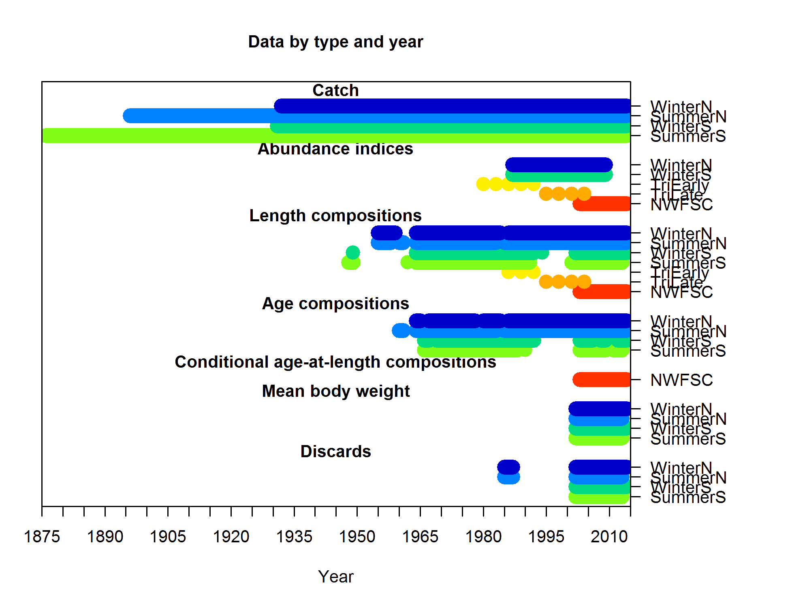
Data summary

Slide 6
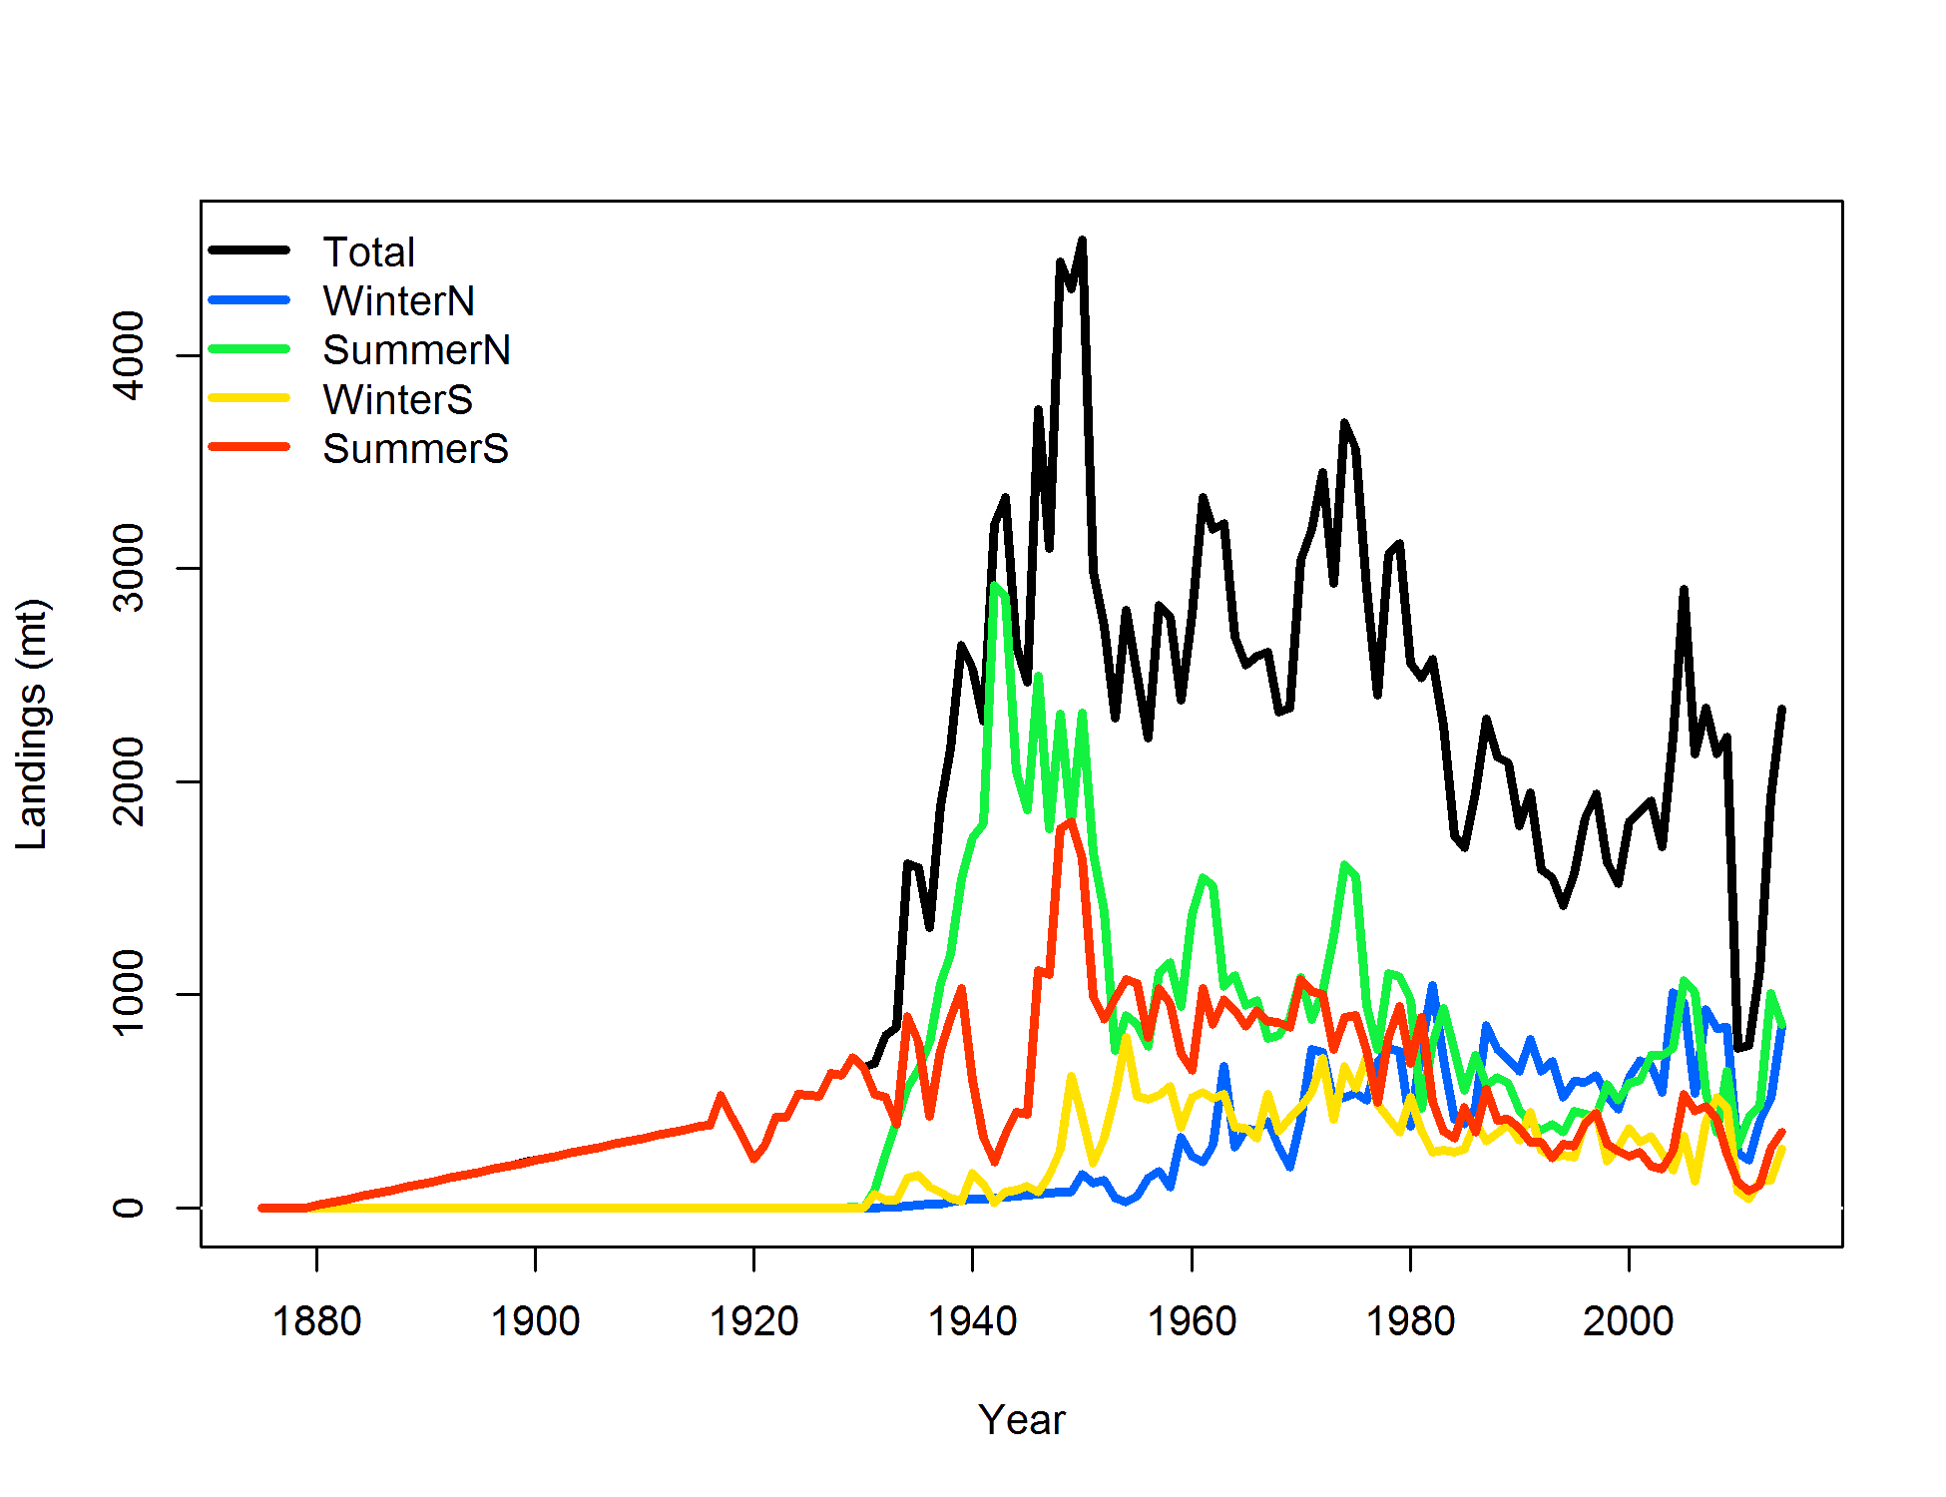
Landings

Slide 7
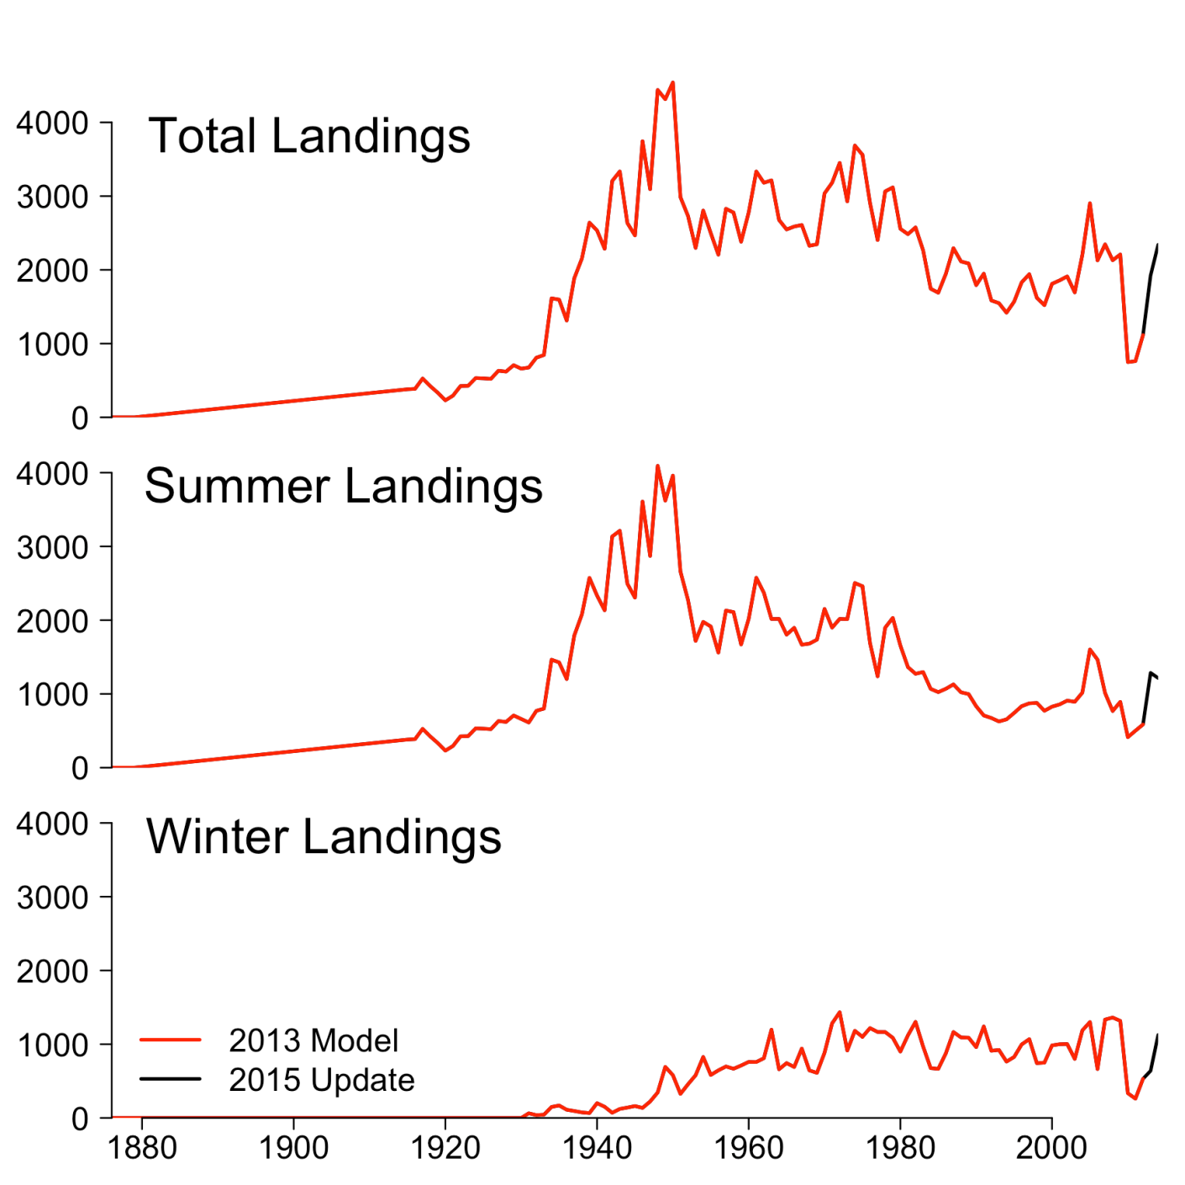
2015 Landings

Slide 8
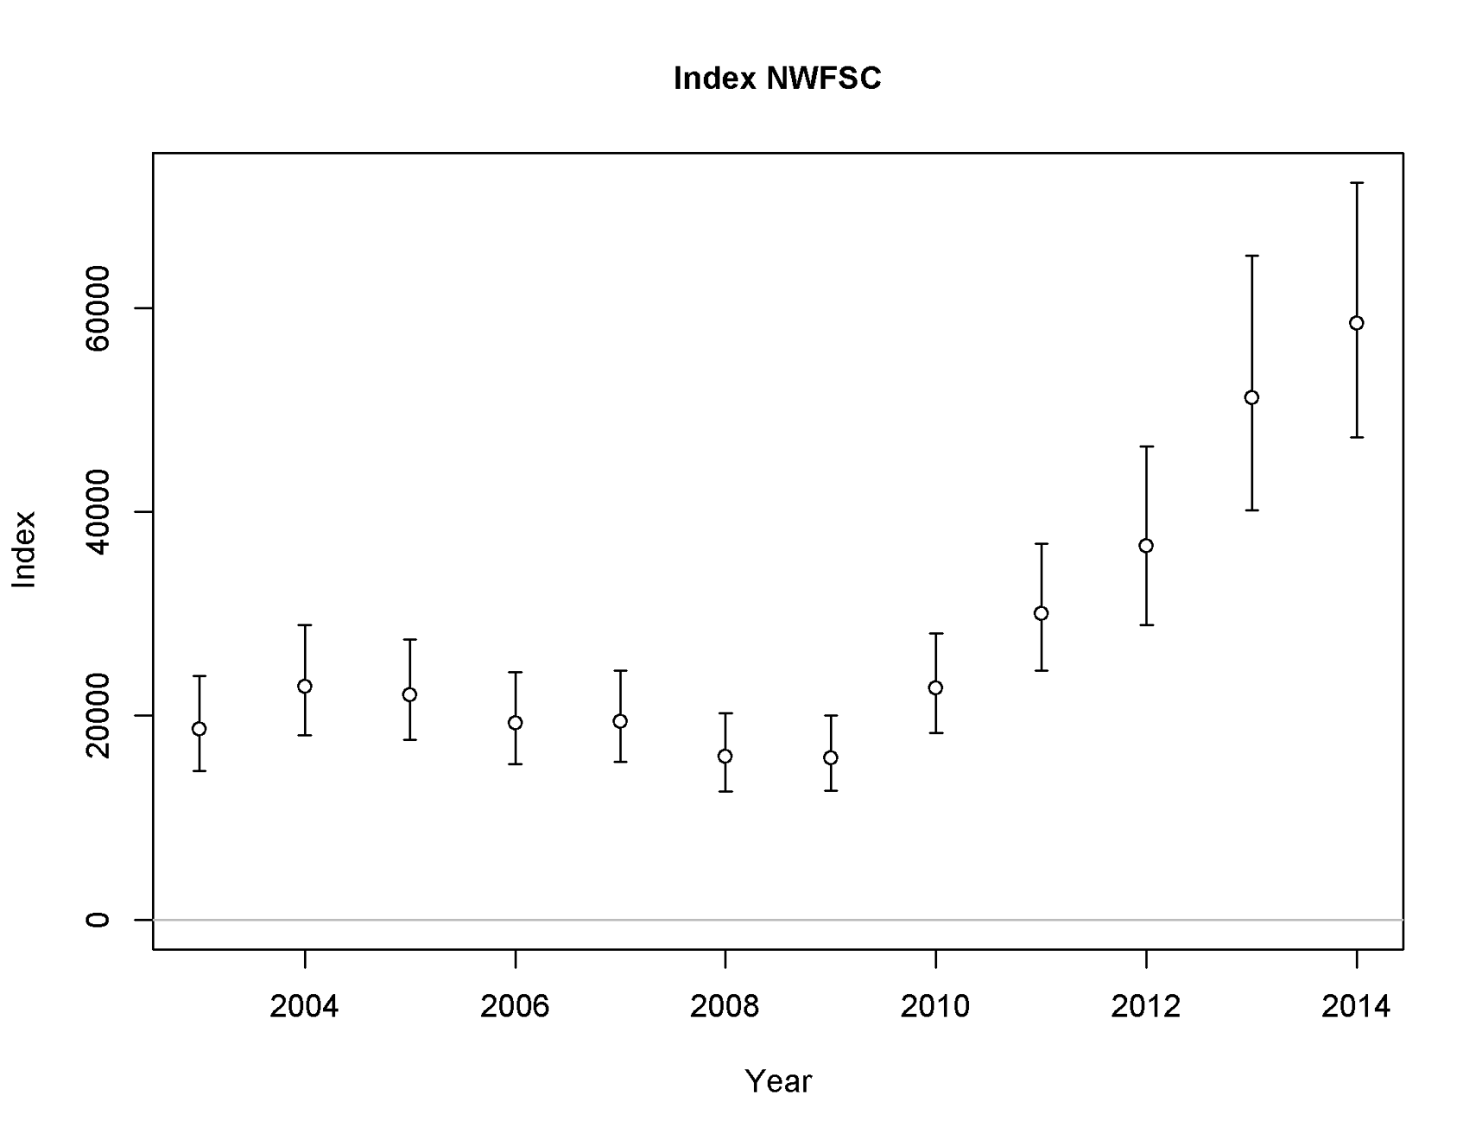
NWFSC survey biomass indices
Notes:
Worked up using Jim Thorson + Eric Ward’s delta-GLMM code. Chosen model from wAIC included lognormal errors. Year, strata, and strata:year were tested as fixed effects. Vessel:year treated as a random effect. Didn’t use extreme catch events. Lognormal model with no strata:year interaction was chosen (alternatives = strata:year as fixed and random effects)

Slide 9
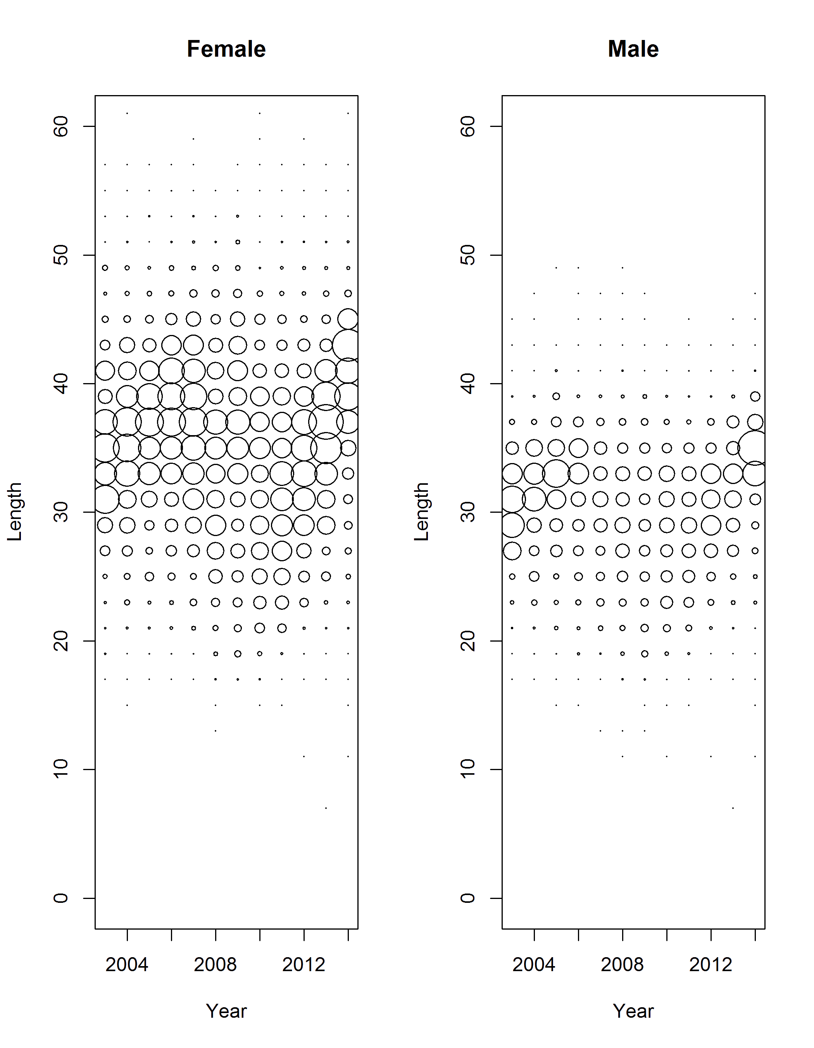
NWFSC survey length frequencies
Notes:
Note strong cohorts during the late 2000s.

Slide 10
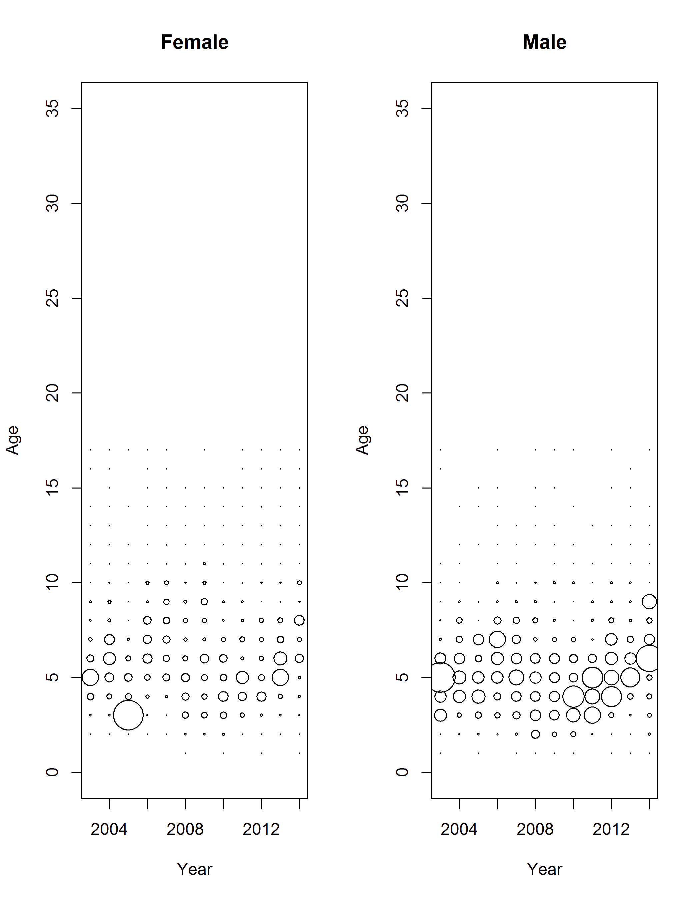
NWFSC survey age frequencies
Notes:
Age data also show strong late 2000s cohorts.
Note that the 2005 age 3 female bubble is large due to the expansion of a small sample to a large catch and is not an error.
Bubbles are proportional within plots but not between plots.

Slide 11
Model description and estimates

Slide 12
Model description – consistent with 2013 assessment
Single-stock coast-wide model
Catches divided among four fishing fleets (winter North, winter South, summer North, summer South)
Sex-specific
Blocks on selectivity and retention
Changes for 2015
Updated SS version
Generalized code for PacFIN biological data used to work up commercial length composition data
Early commercial age data for OR and WA not combined (2011 methods)
Addition of 2013-2014 survey and commercial data
Included most recent survey data to parameterize length-weight relationship

Slide 13
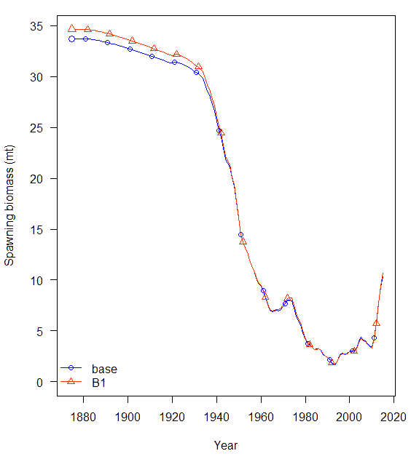
Model Comparison: Commercial Ages 2013 vs. updated commercial ages
Label | WithAges | Without
TOTAL_like | 1472.9 | 1405.4
SSB_Unfished_thousand_mt | 33.7 | 34.6
TotBio_Unfished | 53958.7 | 53804.3
SmryBio_Unfished | 53413.0 | 53299.5
Recr_Unfished_billions | 0.015 | 0.015
SSB_MSY_thousand_mt | 6.944 | 7.292
SPR_MSY | 0.23 | 0.24
Fstd_MSY | 0.21 | 0.19
Bratio_2015 | 0.31 | 0.31
F_2015 | 0.15 | 0.14
SPRratio_2015 | 0.68 | 0.68
Recr_Virgin_billions | 0.02 | 0.01
SR_BH_steep | 0.90 | 0.89
SR_sigmaR | 0.40 | 0.40
NatM_p_1_Fem_GP_1 | 0.14 | 0.14
L_at_Amin_Fem_GP_1 | 15.80 | 15.66
L_at_Amax_Fem_GP_1 | 54.41 | 54.45
VonBert_K_Fem_GP_1 | 0.13 | 0.13
CV_young_Fem_GP_1 | 0.19 | 0.19
CV_old_Fem_GP_1 | 0.03 | 0.03
NatM_p_1_Mal_GP_1 | 0.15 | 0.15
L_at_Amin_Mal_GP_1 | 16.55 | 16.33
L_at_Amax_Mal_GP_1 | 43.20 | 43.26
VonBert_K_Mal_GP_1 | 0.20 | 0.20
CV_young_Mal_GP_1 | 0.14 | 0.14
CV_old_Mal_GP_1 | 0.05 | 0.05

Slide 14
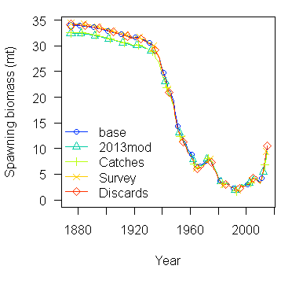
Model change as new data are added
Notes:
Model sensitivity runs given the sequential updating of data from the 2013 full stock assessment. The 2013 mod is the 2013 assessment base model; Catches is the 2013 model with updated commercial landings; Survey further includes the NWFSC trawl survey index and compositions; Discards further includes updated discard rates, mean body weights and discard compositions; and Commercial Comps includes updated commercial compositions. This final run, Commercial Comps, is the 2015 update base case.

Slide 15
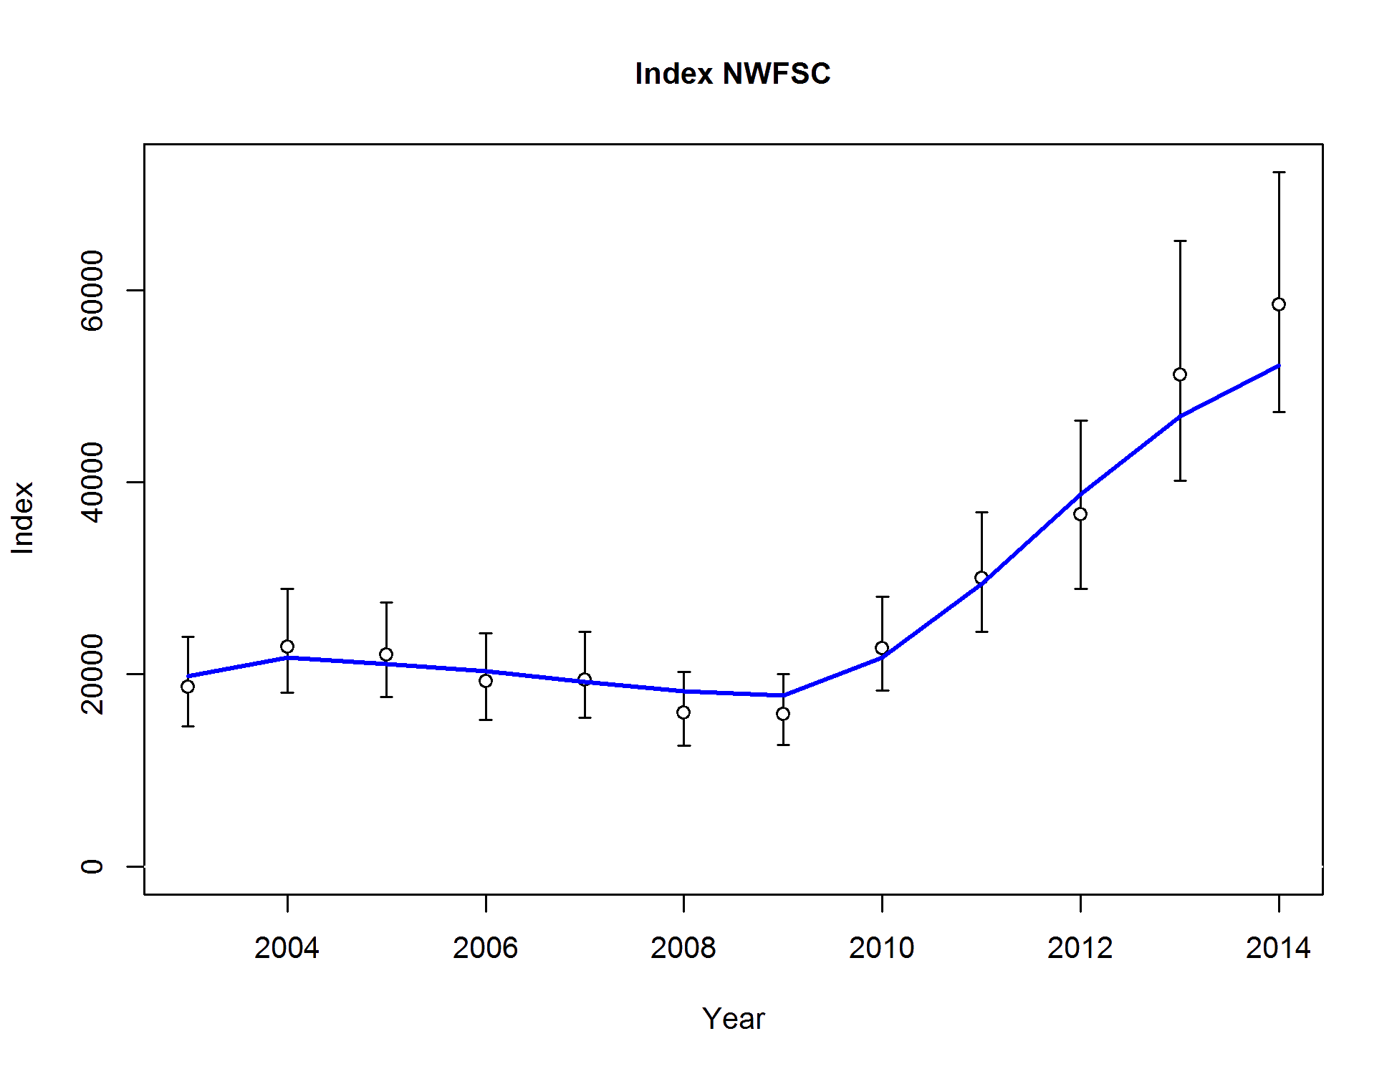
Survey abundance fits

Slide 16
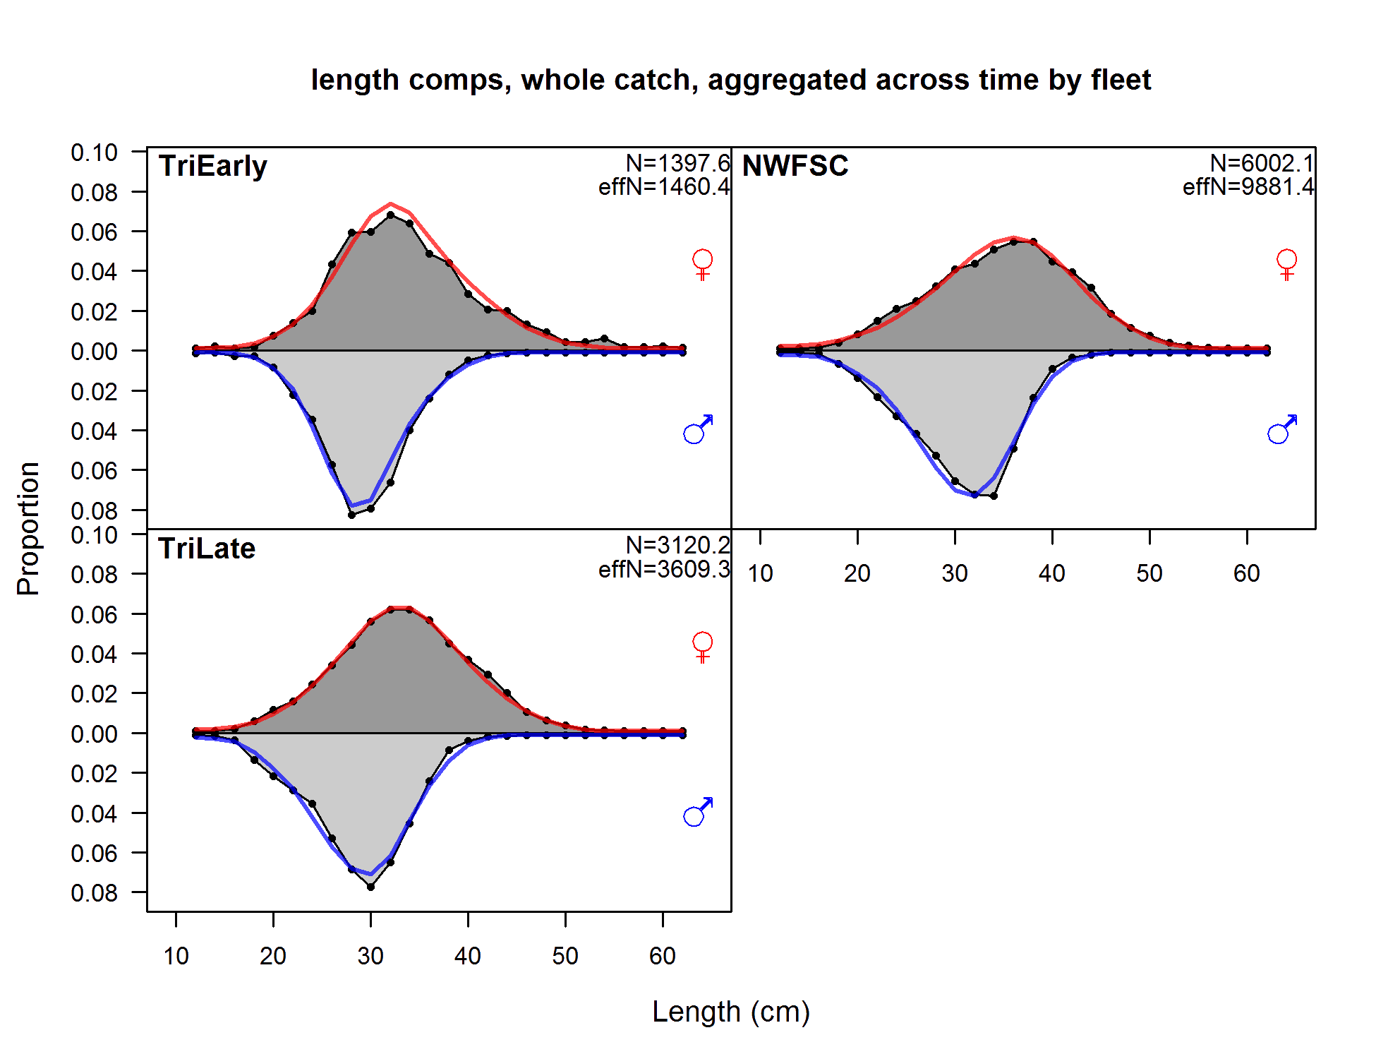
Survey length comp fits

Slide 17
Parameter estimates are consistent with 2013
Parameter | Value 2013 | Value 2015 | ~95% CI
Catchability, Power, Extra SD:
NWFSC survey catchability (q) | 3.36 | 3.65
Triennial survey catchability (q) early | 0.55 | 0.56
Triennial survey catchability (q) late | 0.72 | 0.78
Q_extraSD Triennial survey early | 0.16 | 0.18 | -0.48, 0.21
Q_extraSD Triennial survey late | 0.19 | 0.18 | -1.31, -0.69
Productivity:
R₀ | 9.72 | 9.64 | 9.39, 9.79
Steepness (h) | 0.86 | 0.90 | 0.79, 0.99
Female natural mortality (M) | 0.15 | 0.14 | 0.11, 0.17
Male natural mortality (M) | 0.17 | 0.15 | 0.12, 0.19
Notes:
North winter commercial CPUE (q)
-6.46, 0.59
-12.03, -0.89
0.23, 0.97
South winter commercial CPUE (q)
-0.14, 0.77
-4.74, 4.45
0.32, 1.22
North winter commercial CPUE (Beta)
-0.22
-0.92, 0.47
South winter commercial CPUE (Beta)
-1.01
-1.57, -0.44

Slide 18
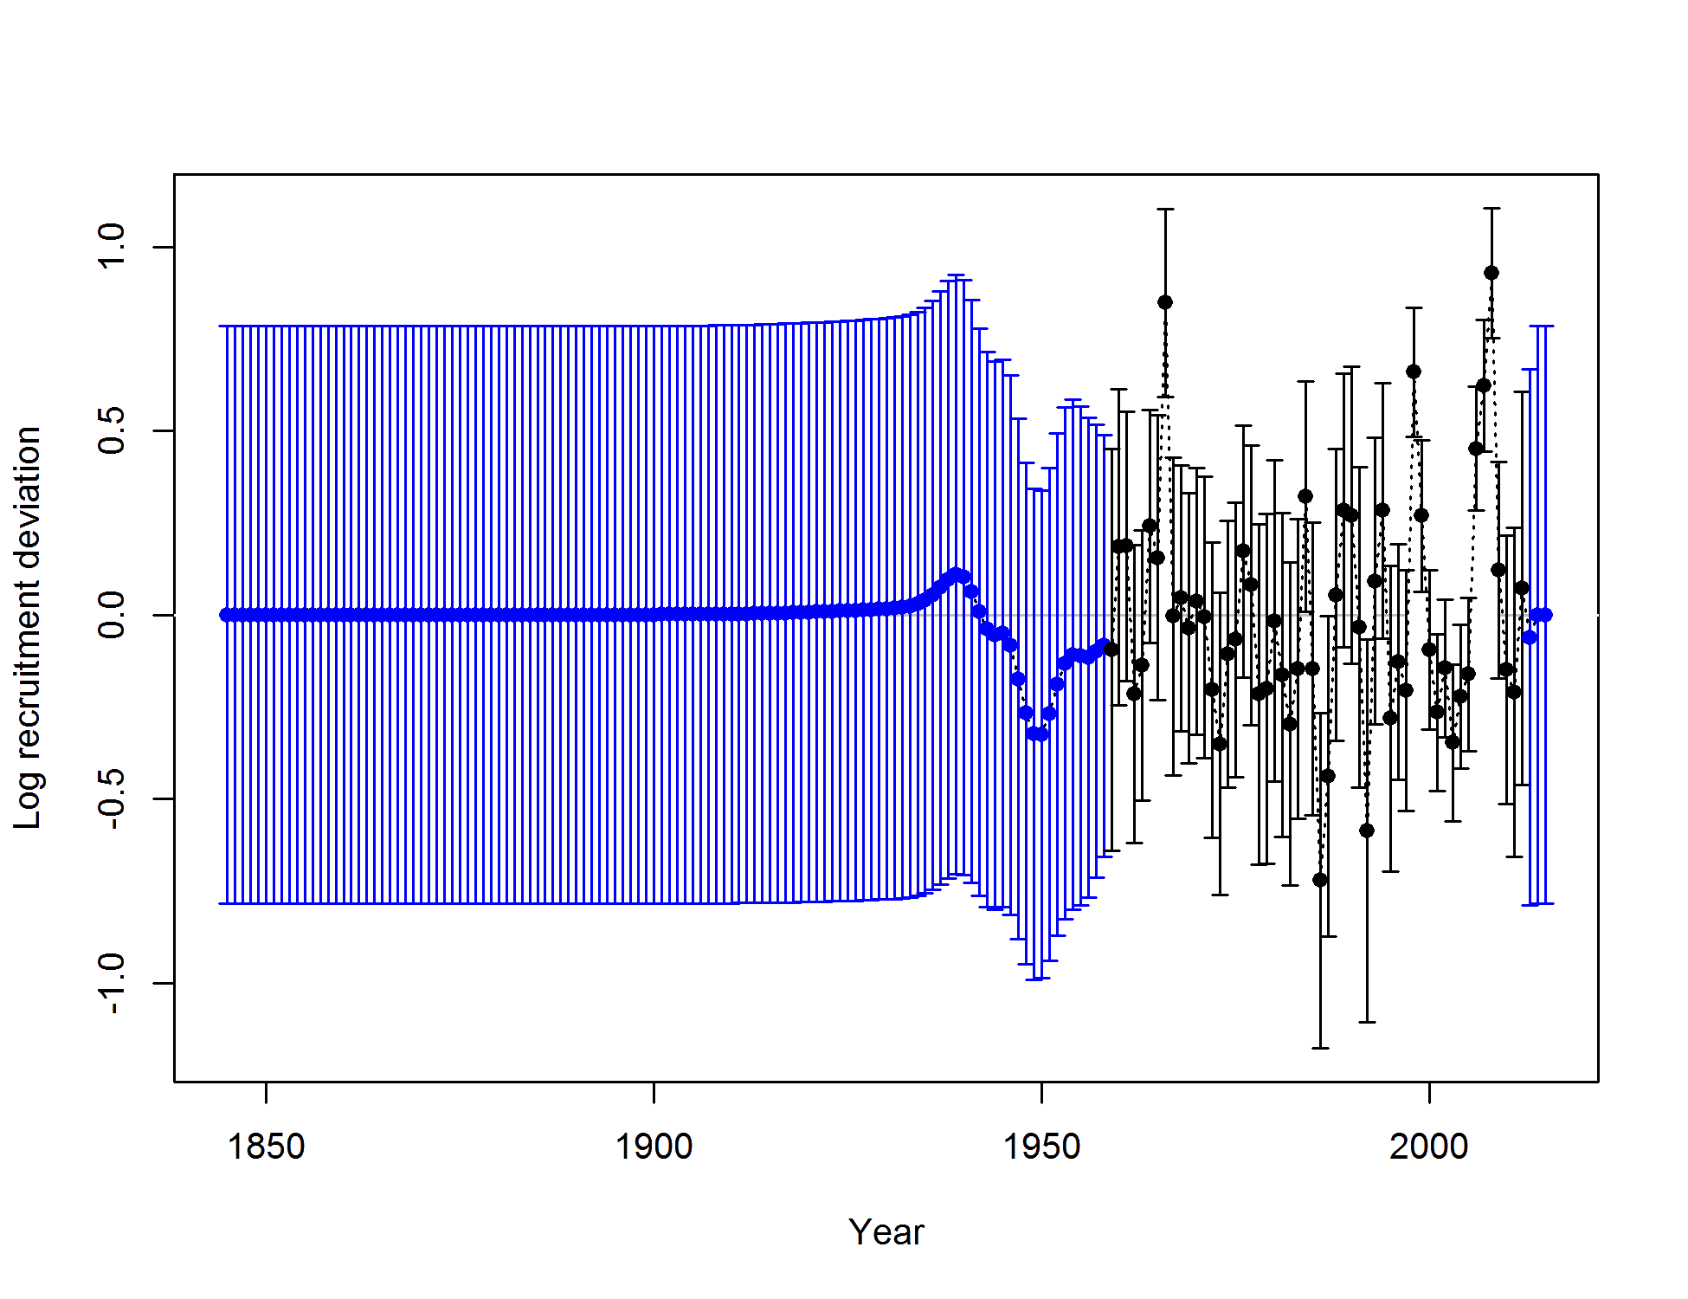
Recruitment deviations - strong recruitment in 2006, 2007, 2008
Notes:
1960, 1967, 1990, 1993, 1997, 1998, 2005 large recruitments
Low recruitment early 2000’s
Explanation for sudden shift in lfs to smaller fish in 2008

Slide 19
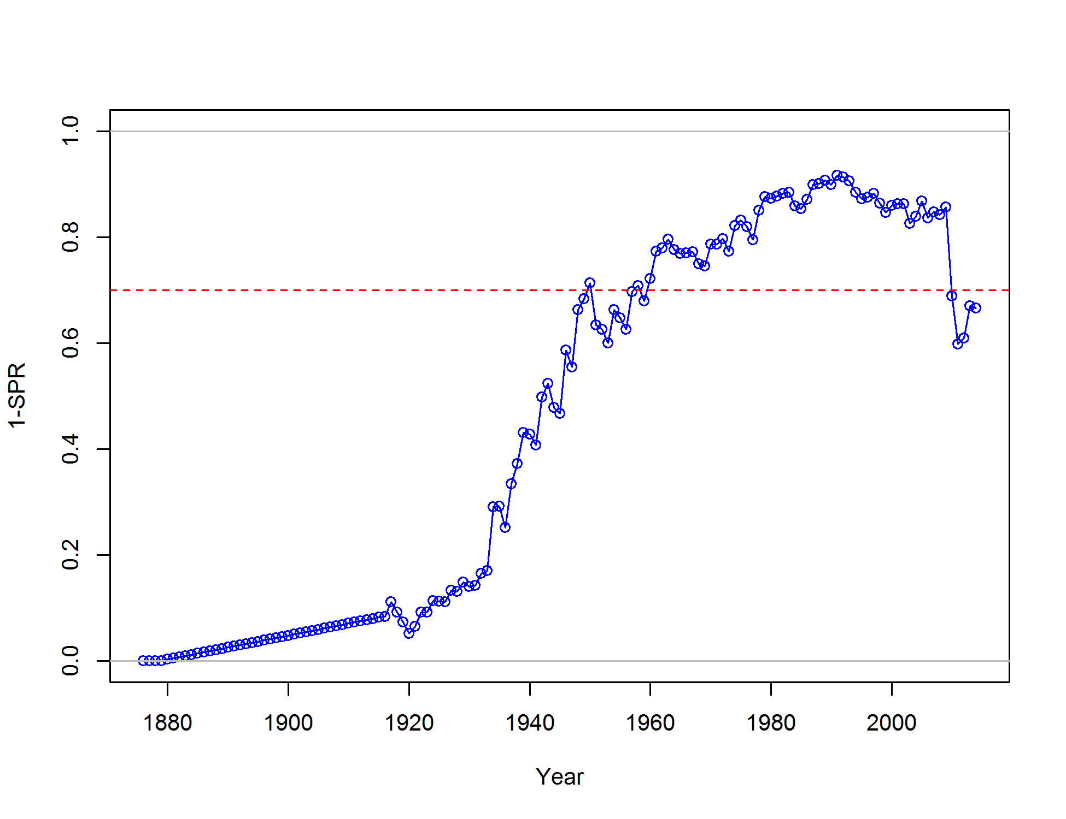
Spawning potential ratio is back below the target

Slide 20
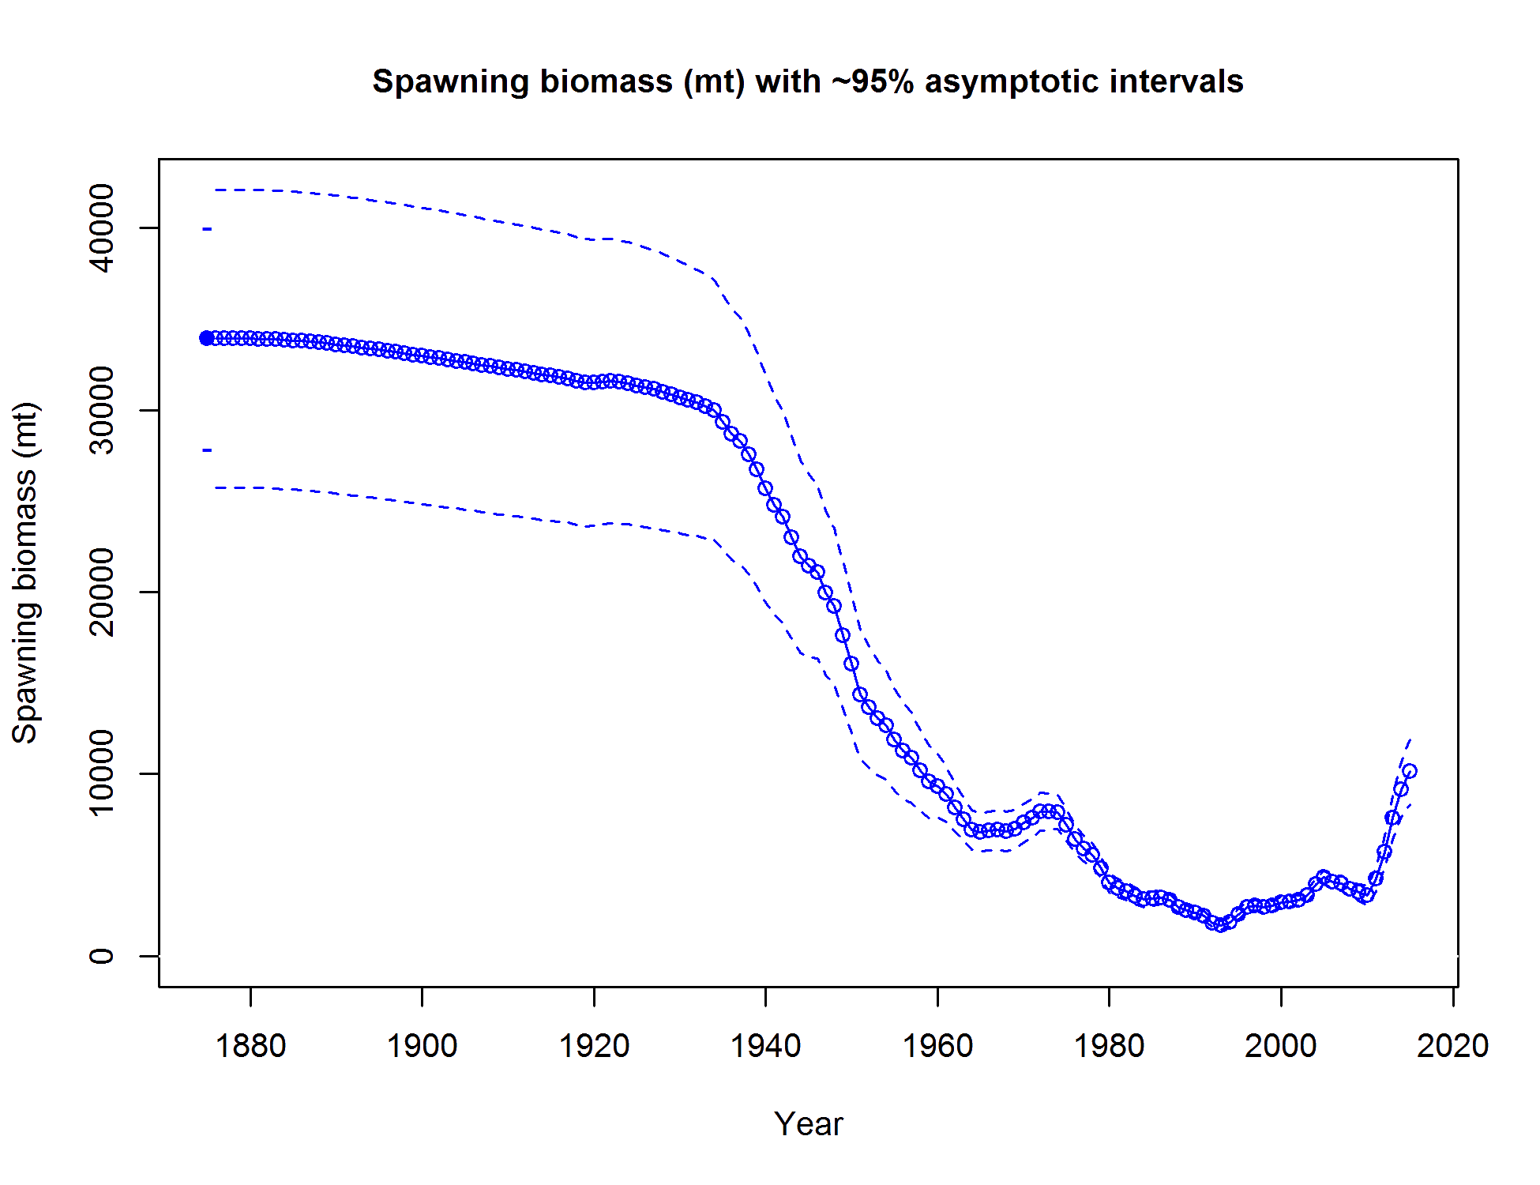
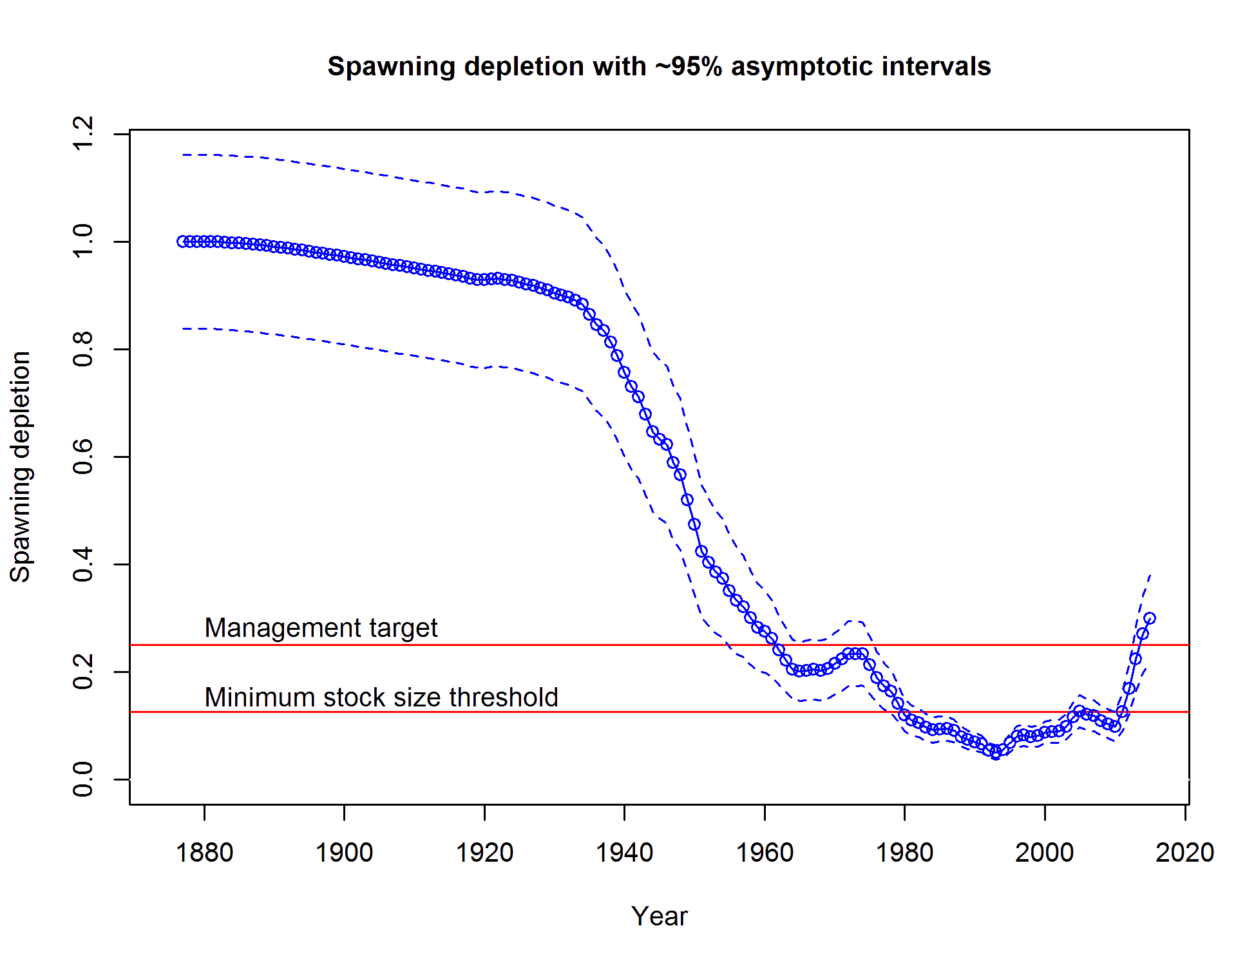
Biomass trajectory – rebuilt!

Slide 21
Model explorations and sensitivity

Slide 22
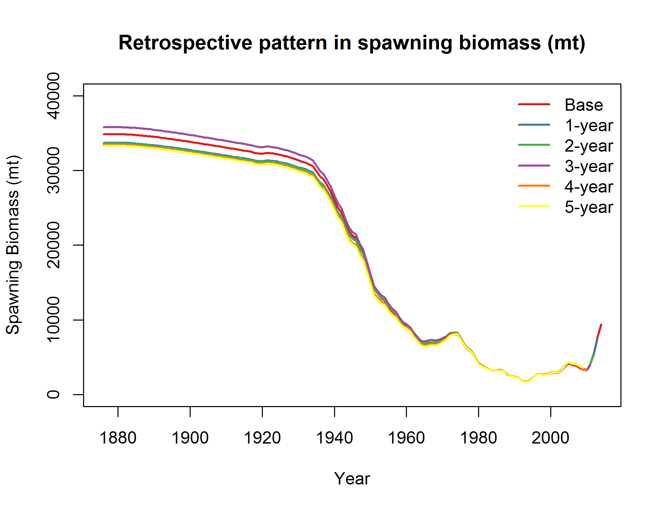
No clear retrospective pattern

Slide 23
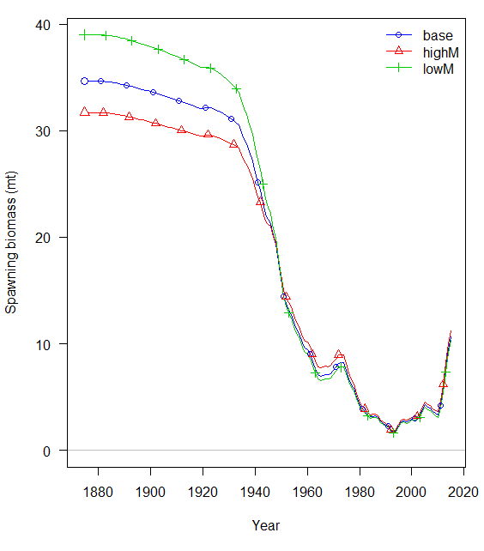
Sensitivity to female M – does not affect recent years
M=.17
M=.12
Notes:
Figure 125. Spawning biomass for sensitivity to model structure for the base model (blue), model with high female M (red), and low female M. high M = .16, low M = .12

Slide 24
Female M does not have a large impact on estimates
Label | Base | High M | Low M
SR_BH_steep | 0.90 | 0.84 | 0.95
NatM_p_1_Fem_GP_1 | 0.15 | 0.17 | 0.12
L_at_Amin_Fem_GP_1 | 15.79 | 15.73 | 15.90
L_at_Amax_Fem_GP_1 | 54.41 | 54.50 | 54.33
VonBert_K_Fem_GP_1 | 0.13 | 0.13 | 0.13
SSB_Unfished_thou_mt | 33.65 | 30.79 | 37.49
Bratio_2014 | 0.28 | 0.32 | 0.23
Bratio_2015 | 0.31 | 0.35 | 0.26
F_2014 | 0.13 | 0.12 | 0.13
F_2015 | 0.15 | 0.14 | 0.15
SSB_Btgt_thou_mt | 8.41 | 7.70 | 9.37
SPR_Btgt | 0.27 | 0.29 | 0.26
Fstd_Btgt | 0.18 | 0.19 | 0.16
TotYield_Btgt_thou_mt | 2.94 | 3.00 | 2.80
SSB_SPRtgt_thou_mt | 9.43 | 8.17 | 10.90
Fstd_SPRtgt | 0.16 | 0.18 | 0.14
TotYield_SPRtgt_thou_mt | 2.90 | 2.99 | 2.74

Slide 25
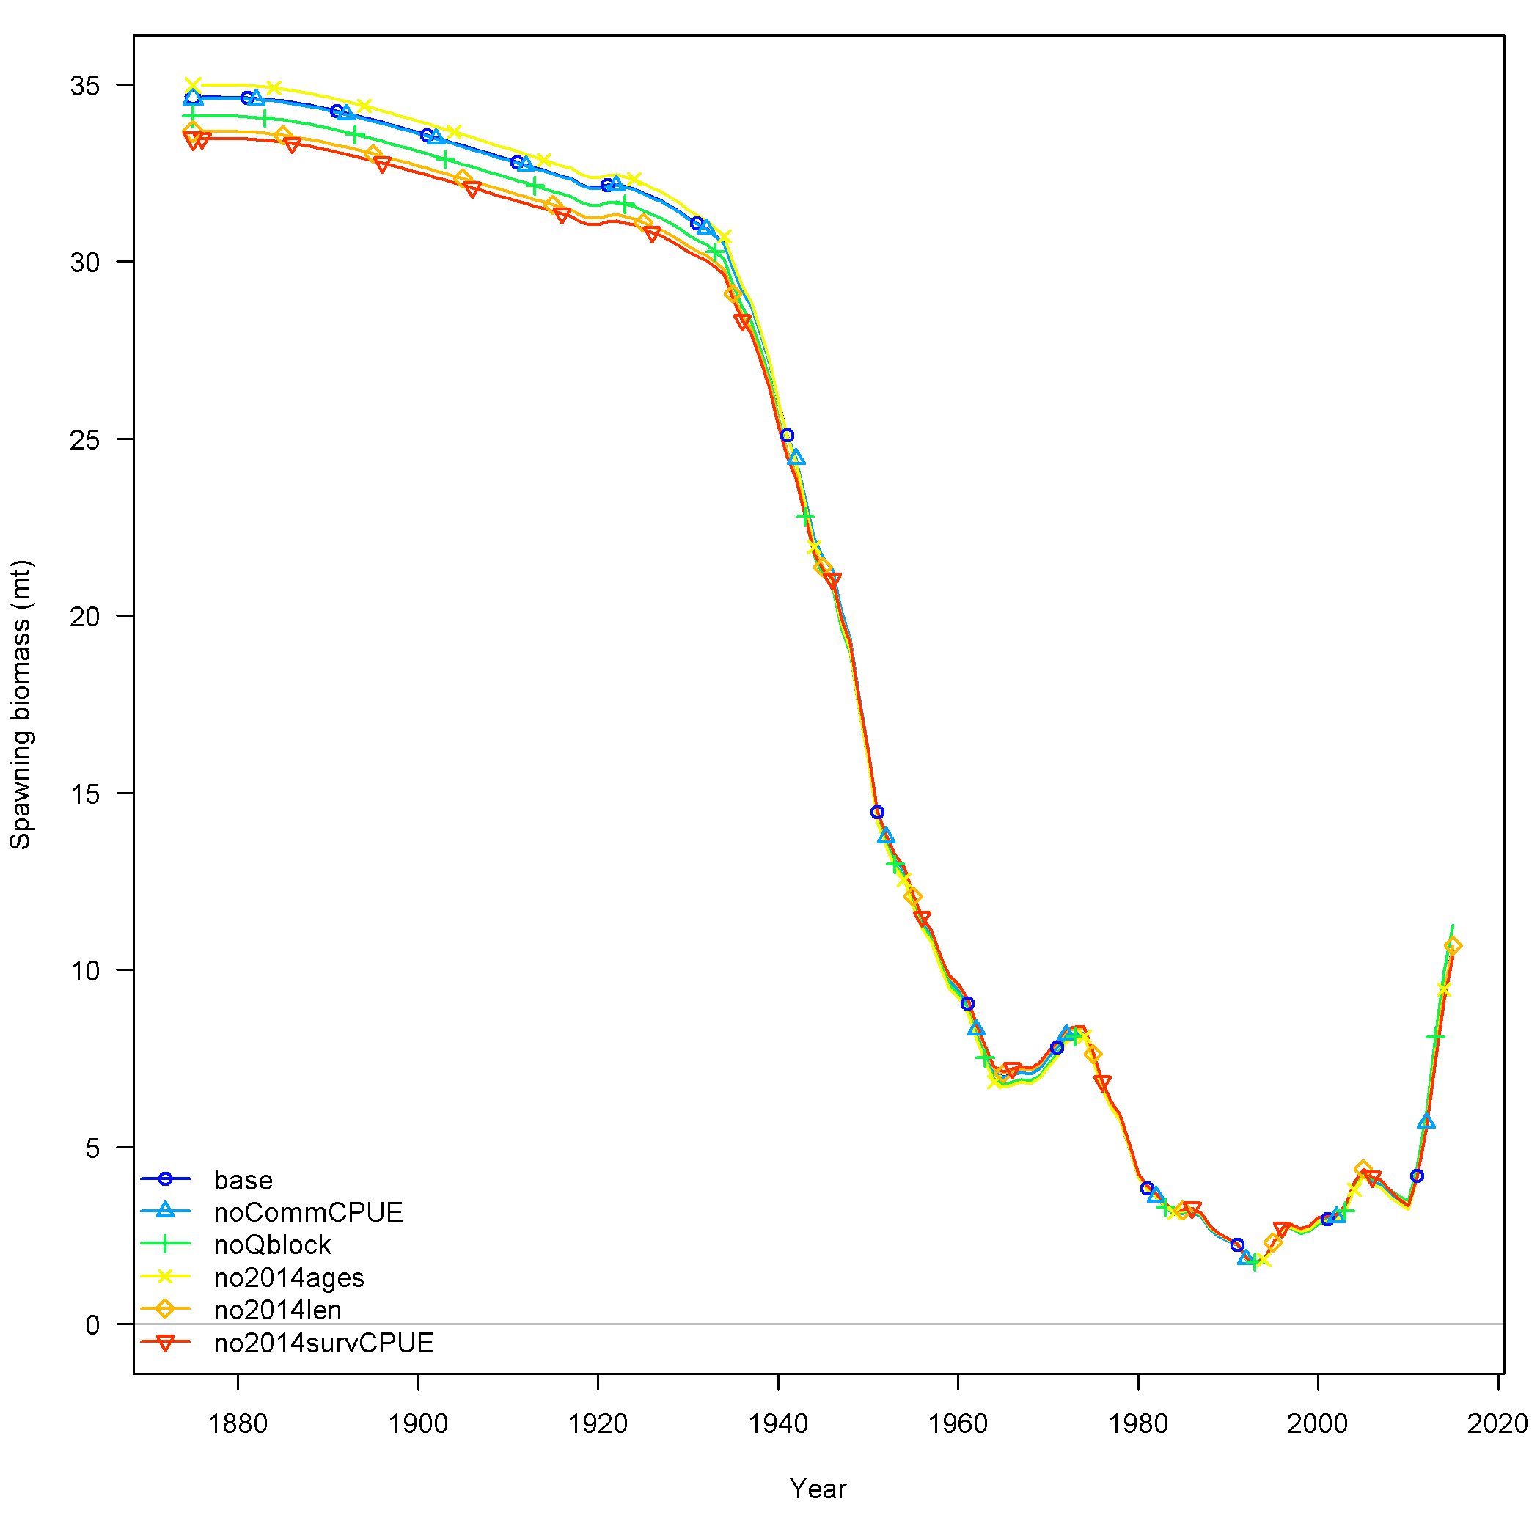
Sensitivity to treatment of comm CPUE and removal of 2014 survey – also minimal
Notes:
Figure 126. Spawning biomass for sensitivity to the treatment of the winter commercial CPUE for the base model (blue), the model removing the winter commercial CPUE (green), the model increasing the standard deviations from the bootstrap by adding the maximum value estimated for the NWFSC survey (light green), the model allowing for time varying q between 2006-2009 (ornange), and the model allowing for a time block in q between 2003 and 2004.

Slide 26
Removal of comm. CPUE and 2014 survey also has minimal impact
Label | Base | No Comm. CPUE | No block on Q | No 2014 age comp | No 2014 length comp | No 2014 survey CPUE, comp
SR_BH_steep | 0.89 | 0.89 | 0.88 | 0.9 | 0.87 | 0.87
NatM_p_1_Fem_GP_1 | 0.14 | 0.14 | 0.15 | 0.14 | 0.15 | 0.15
L_at_Amin_Fem_GP_1 | 15.66 | 15.66 | 15.74 | 15.7 | 15.59 | 15.46
L_at_Amax_Fem_GP_1 | 54.45 | 54.42 | 54.37 | 54.51 | 54.45 | 54.54
VonBert_K_Fem_GP_1 | 0.13 | 0.13 | 0.13 | 0.13 | 0.13 | 0.13
SSB_Unfished_thou_mt | 34.64 | 34.61 | 34.1 | 34.98 | 33.67 | 33.48
Bratio_2014 | 0.27 | 0.27 | 0.29 | 0.27 | 0.28 | 0.27
Bratio_2015 | 0.31 | 0.31 | 0.33 | 0.31 | 0.32 | 0.31
F_2014 | 0.12 | 0.12 | 0.12 | 0.12 | 0.12 | 0.12
F_2015 | 0.14 | 0.14 | 0.13 | 0.14 | 0.14 | 0.14
SSB_Btgt_thou_mt | 8.66 | 8.65 | 8.53 | 8.75 | 8.42 | 8.37
SPR_Btgt | 0.27 | 0.27 | 0.28 | 0.27 | 0.28 | 0.28
Fstd_Btgt | 0.17 | 0.17 | 0.17 | 0.16 | 0.17 | 0.17
TotYield_Btgt_thou_mt | 2.78 | 2.78 | 2.76 | 2.75 | 2.8 | 2.79
SSB_SPRtgt_thou_mt | 9.61 | 9.6 | 9.39 | 9.77 | 9.19 | 9.13
Fstd_SPRtgt | 0.15 | 0.15 | 0.15 | 0.15 | 0.16 | 0.16
TotYield_SPRtgt_thou_mt | 2.75 | 2.75 | 2.74 | 2.71 | 2.77 | 2.77

Slide 27
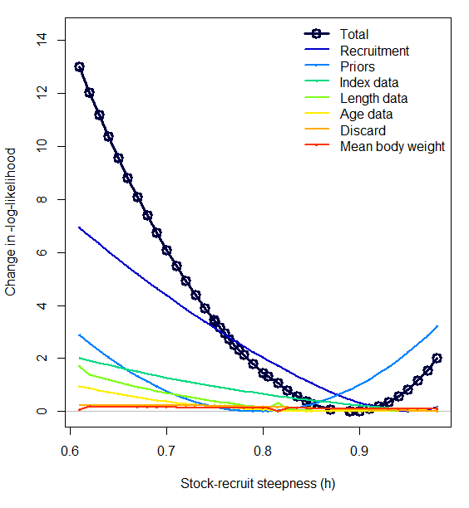
Steepness likelihood profile

Slide 28
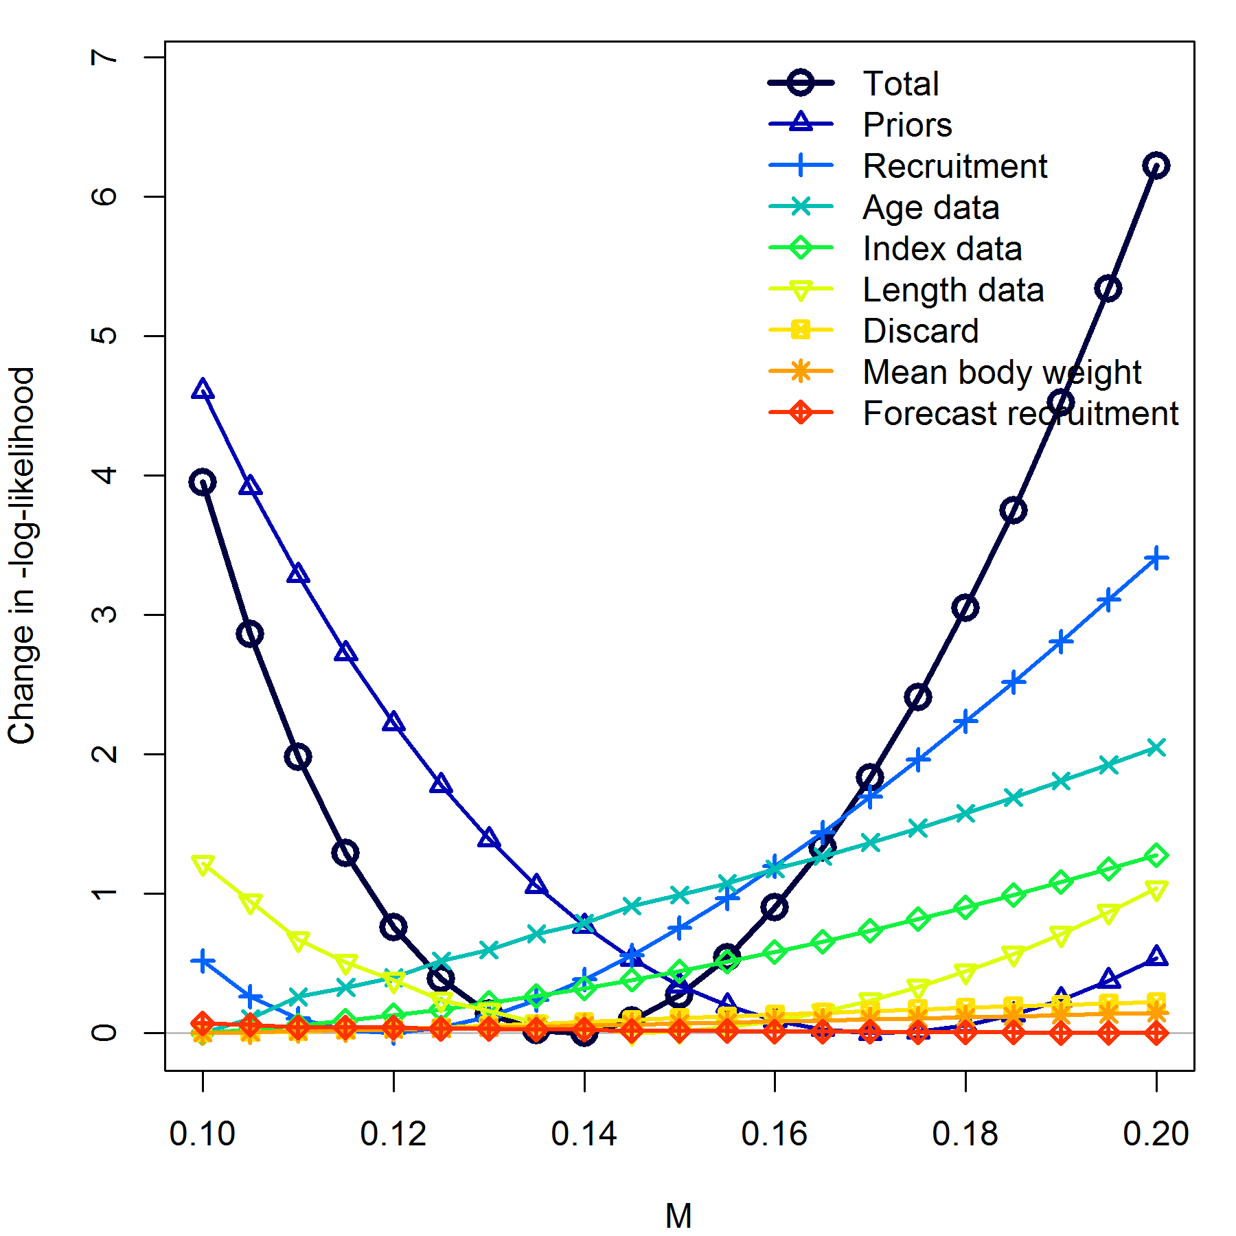
Female M likelihood profile

Slide 29
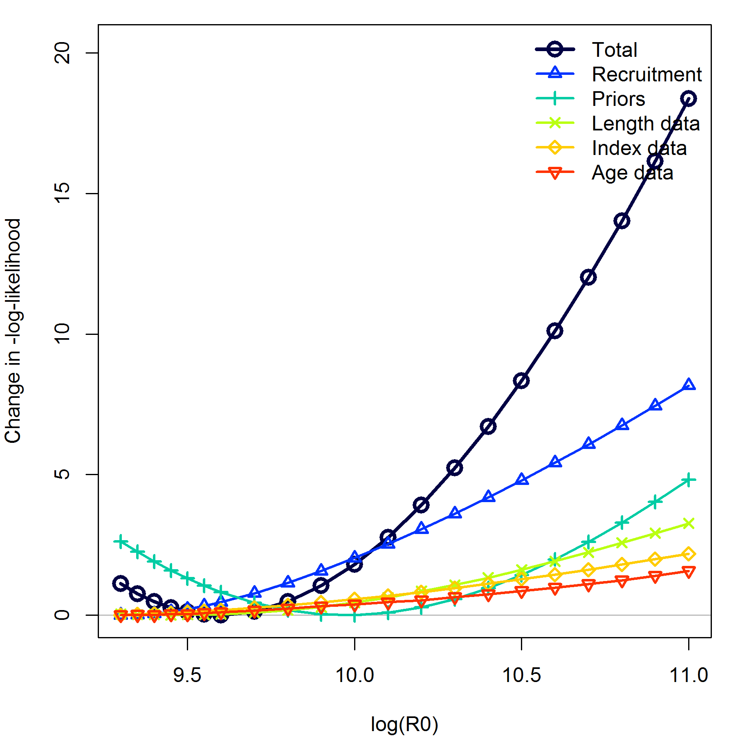
R₀ likelihood profile

Slide 30
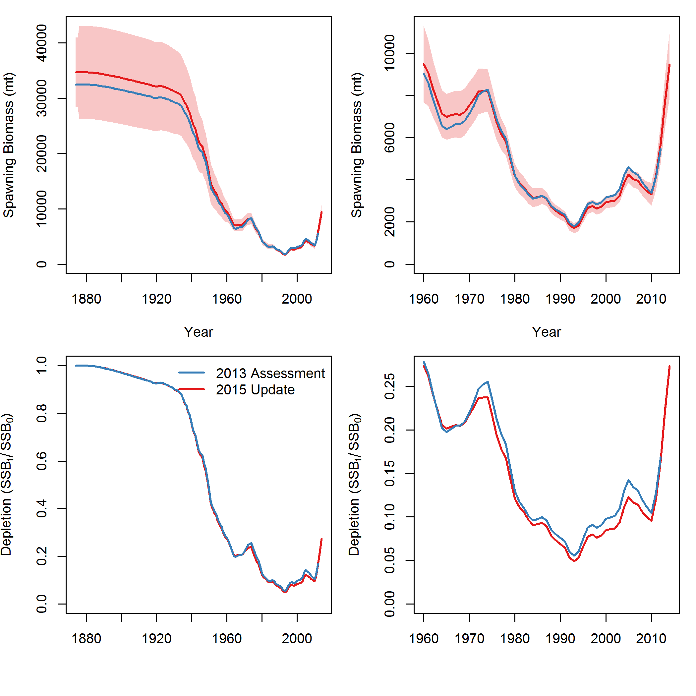
2015 assessment is similar to 2013
Notes:
Comparisons of the model estimated spawning biomass and stock depletion for the 2013 and 2015 assessment models. The ~95% confidence intervals from the 2015 model are shown as a light red polygon

Slide 31
Decision table and takeaways

Slide 32
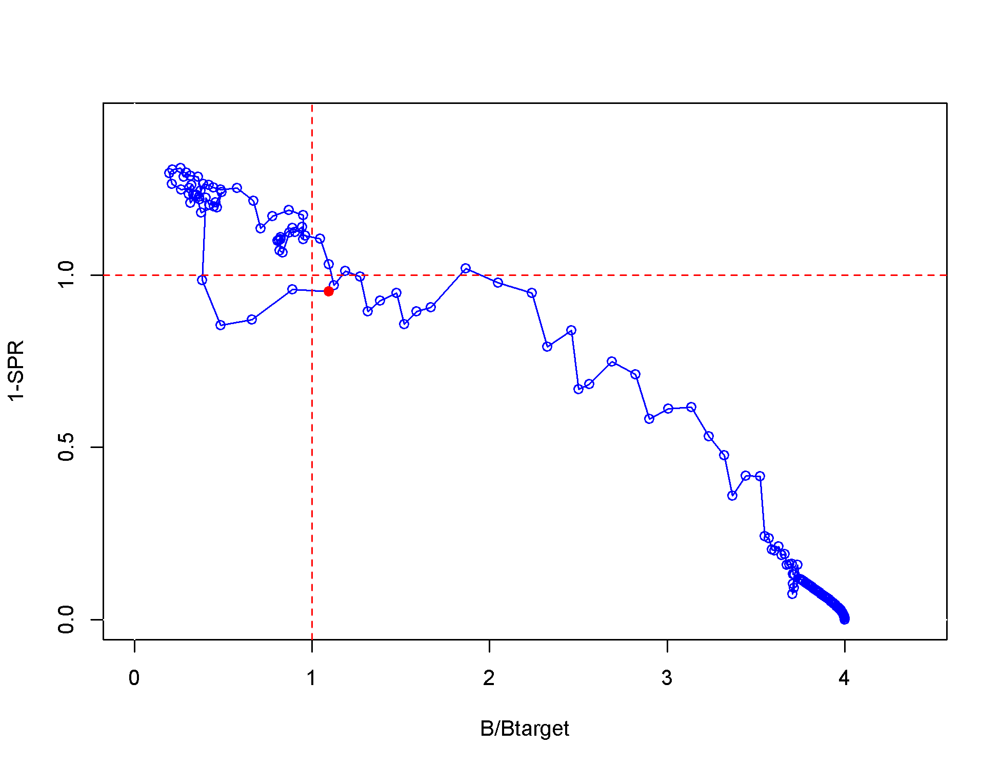
Management performance
SPR Ratio

Slide 33
Model projections
Year | Predicted OFL (mt) | ACL Catch (mt) | Age 3+ biomass (mt) | Spawning Biomass (mt) | Depletion (%)
2015 | 3,195 | 2,816 | 19,355 | 10,290 | 0.31
2016 | 3,304 | 2,910 | 19,360 | 10,512 | 0.31
2017 | 3,281 | 3,150 | 19,183 | 10,358 | 0.31
2018 | 3,152 | 3,027 | 18,747 | 9,964 | 0.3
2019 | 3,042 | 2,921 | 18,458 | 9,669 | 0.29
2020 | 2,976 | 2,858 | 18,324 | 9,510 | 0.28
2021 | 2,950 | 2,832 | 18,301 | 9,460 | 0.28
2022 | 2,949 | 2,832 | 18,336 | 9,474 | 0.28
2023 | 2,960 | 2,842 | 18,392 | 9,515 | 0.28
2024 | 2,974 | 2,855 | 18,446 | 9,558 | 0.29
2025 | 2,985 | 2,866 | 18,489 | 9,595 | 0.29
2026 | 2,994 | 2,874 | 18,521 | 9,622 | 0.29
Notes:
Table g. Projection of potential OFL, ACL, landings, and catch, summary biomass (age-3 and older), spawning biomass, and depletion projected with status quo catches in 2015 and 2016, and catches at the ACL from 2017 forward. The 2015 and 2016 ACL’s are values specified by the PFMC and not predicted by this assessment. The ACL from 2017 forward is the calculated total catch determined by F_{SPR}.

Slide 34
State of nature |  |  | Low female M = 0.12 |  | Base case female M = 0.145 |  | High female M = 0.17
Relative probability |  |  | 0.25 |  | 0.50 |  | 0.25
 | Year | Catch (mt) | Spawning biomass (mt) | Depletion | Spawning biomass (mt) | Depletion | Spawning biomass (mt) | Depletion
ABC 25:5 Rule | 2017 | 3112 | 10168 | 0.271 | 10,358 | 0.31 | 10607 | 0.345
 | 2018 | 3028 | 9901 | 0.264 | 9,964 | 0.3 | 10146 | 0.330
 | 2019 | 2940 | 9652 | 0.257 | 9,669 | 0.29 | 9796 | 0.318
 | 2020 | 2872 | 9471 | 0.253 | 9,510 | 0.28 | 9605 | 0.312
 | 2021 | 2828 | 9361 | 0.250 | 9,460 | 0.28 | 9549 | 0.310
 | 2022 | 2802 | 9305 | 0.248 | 9,474 | 0.28 | 9580 | 0.311
 | 2023 | 2788 | 9283 | 0.248 | 9,515 | 0.28 | 9654 | 0.314
 | 2024 | 2780 | 9280 | 0.248 | 9,558 | 0.29 | 9742 | 0.316
 | 2025 | 2775 | 9288 | 0.248 | 9,595 | 0.29 | 9829 | 0.319
 | 2026 | 2772 | 9301 | 0.248 | 9,622 | 0.29 | 9910 | 0.322
SPR target = 0.45; Biomass target = 0.3 | 2017 | 1711 | 10168 | 0.271 | 10400 | 0.309 | 10607 | 0.345
 | 2018 | 1804 | 10750 | 0.287 | 10867 | 0.323 | 10968 | 0.356
 | 2019 | 1877 | 11273 | 0.301 | 11304 | 0.336 | 11324 | 0.368
 | 2020 | 1941 | 11760 | 0.314 | 11738 | 0.349 | 11702 | 0.380
 | 2021 | 1998 | 12214 | 0.326 | 12164 | 0.361 | 12091 | 0.393
 | 2022 | 2050 | 12632 | 0.337 | 12570 | 0.373 | 12466 | 0.405
 | 2023 | 2096 | 13011 | 0.347 | 12942 | 0.385 | 12812 | 0.416
 | 2024 | 2136 | 13351 | 0.356 | 13279 | 0.395 | 13121 | 0.426
 | 2025 | 2171 | 13654 | 0.364 | 13579 | 0.403 | 13393 | 0.435
 | 2026 | 2200 | 13923 | 0.371 | 13846 | 0.411 | 13633 | 0.443
Notes:
Todo: update with new decision table values.

Slide 35
Acknowledgements
Andi Stephens
Allan Hicks
Jim Thorson and Eric Ward
Caitlin Allen, Maite Pons, Lee Qi, Merrill Rudd
Ian Taylor
NOAA Fisheries/Sea Grant Population Dynamics Fellowship
Notes:
Should probably add the sources we used to travel to the meeting?

Slide 36
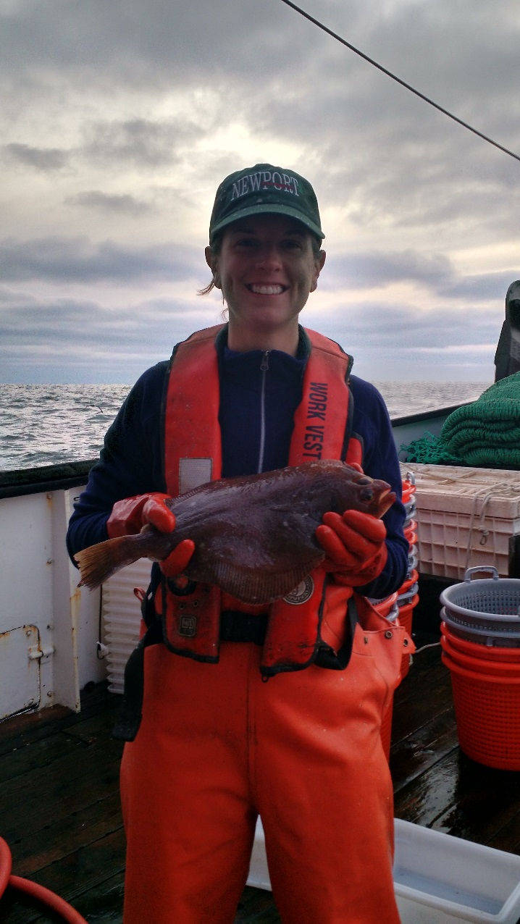
Questions?

Slide 37
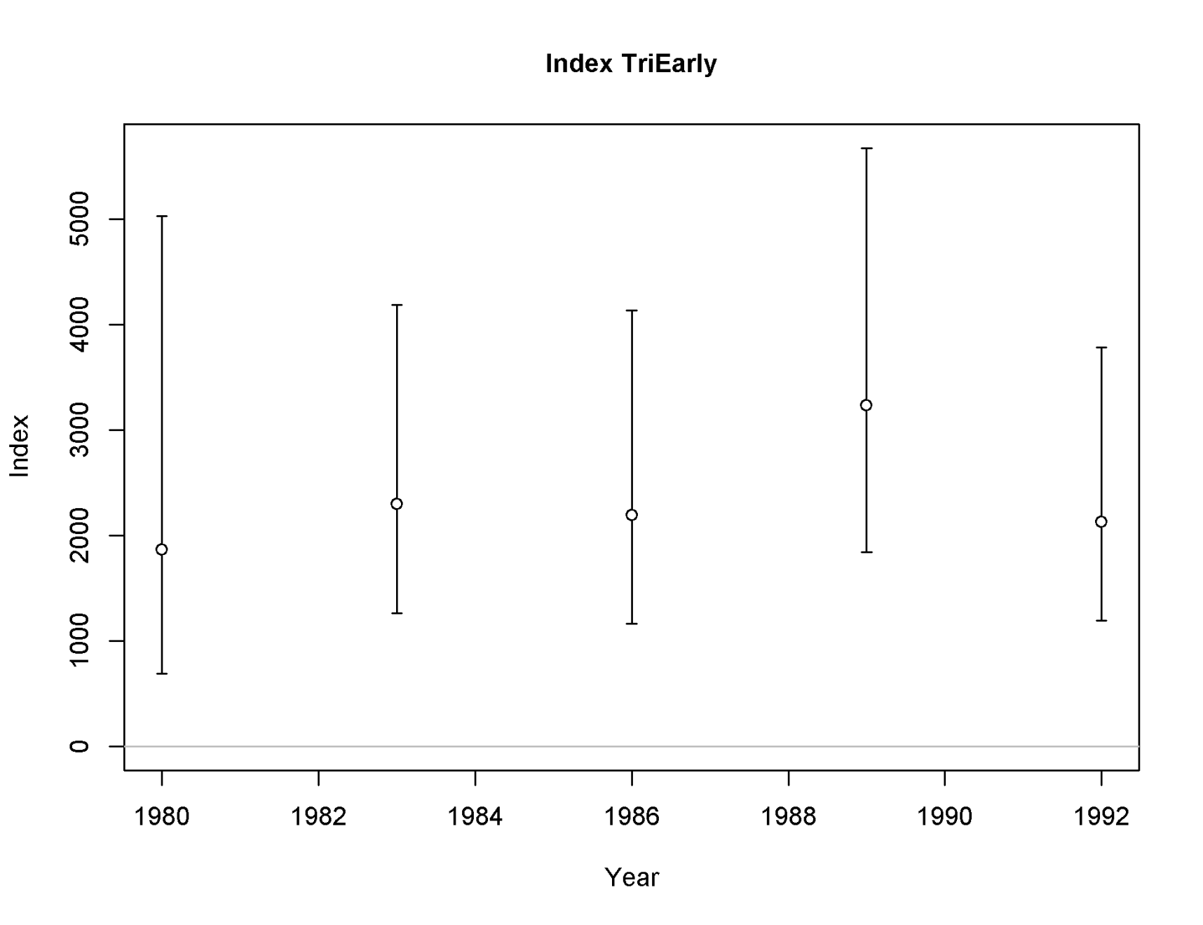
Survey biomass indices
Notes:
Design based similar to glmm
2004 triennial much larger
Nwfsc more than twice the triennial

Slide 38
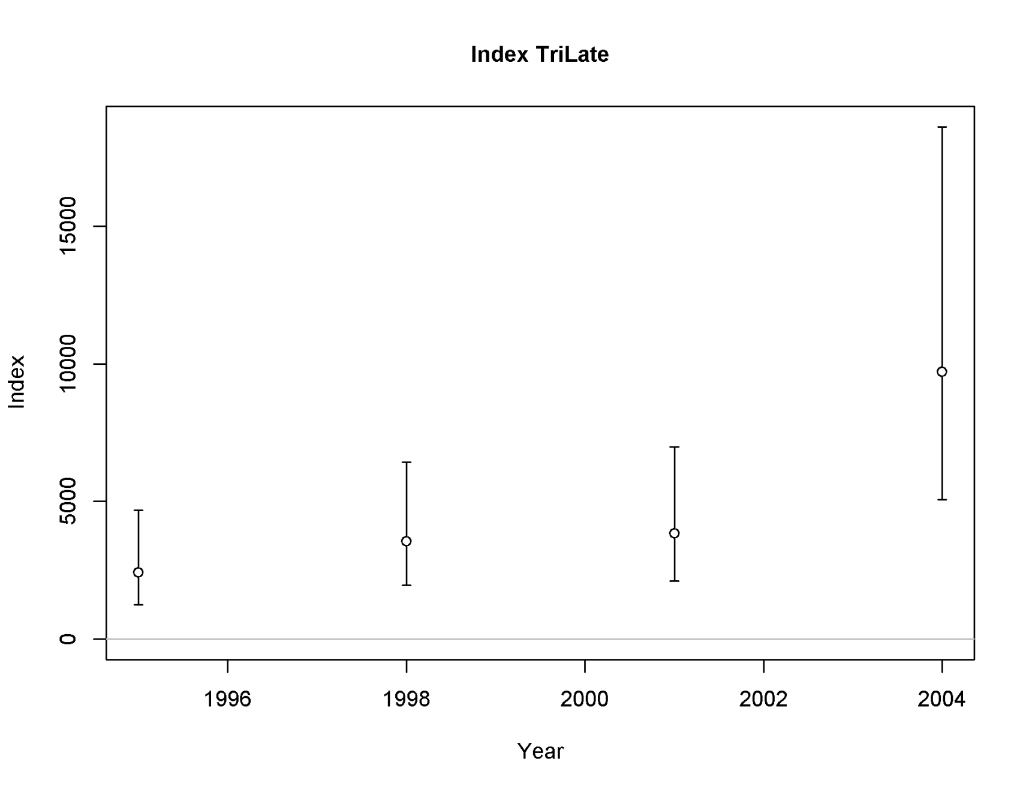
Survey biomass indices
Notes:
Design based similar to glmm
2004 triennial much larger
Nwfsc more than twice the triennial

Slide 39
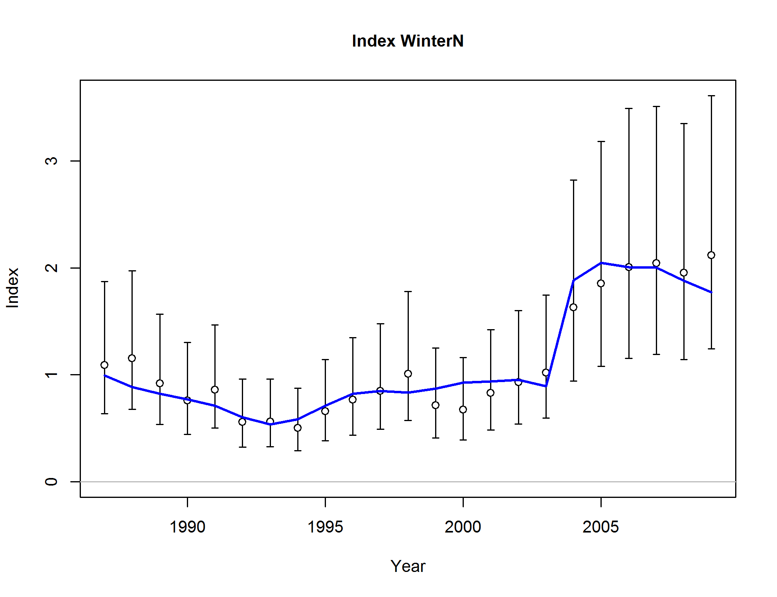
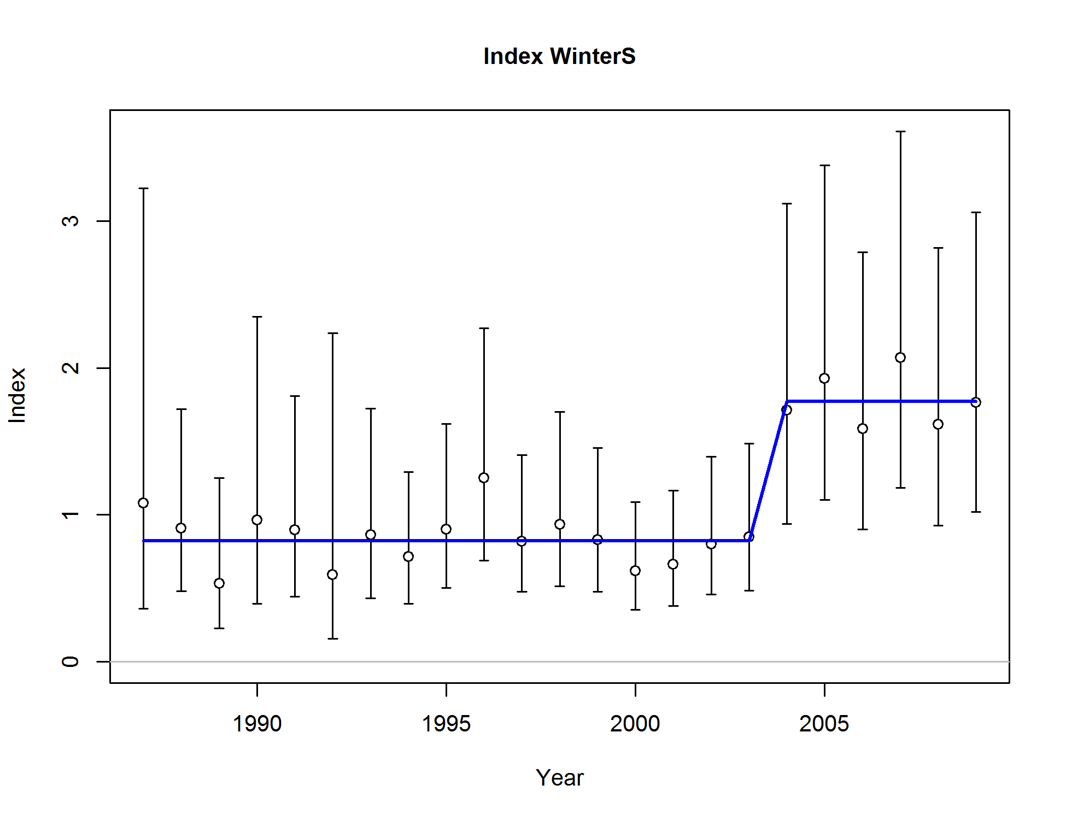
Winter standardized commercial CPUE fits
Notes:
Fit with a time step in q between 2003-2004 to account for decreased fishing effort for winter petrale after the vessel buy back program.

Slide 40
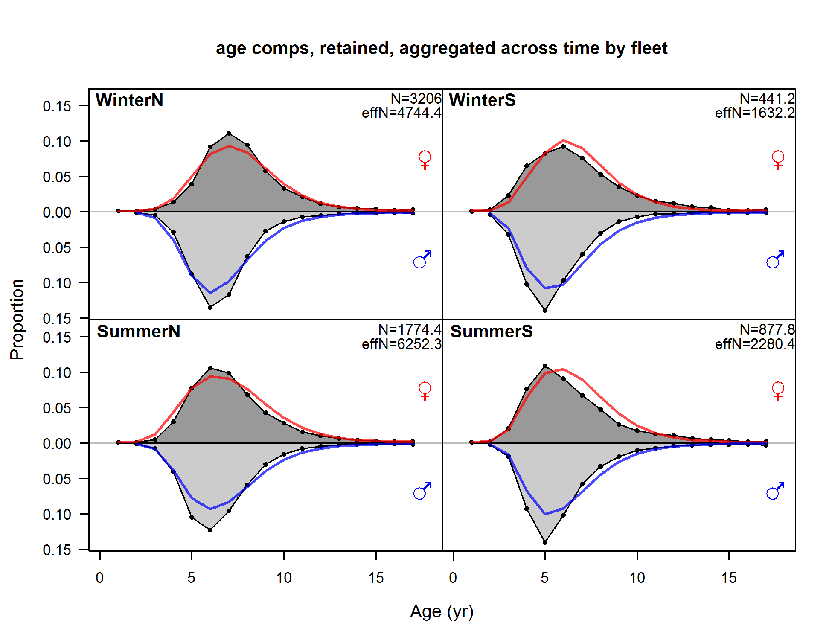

Slide 41
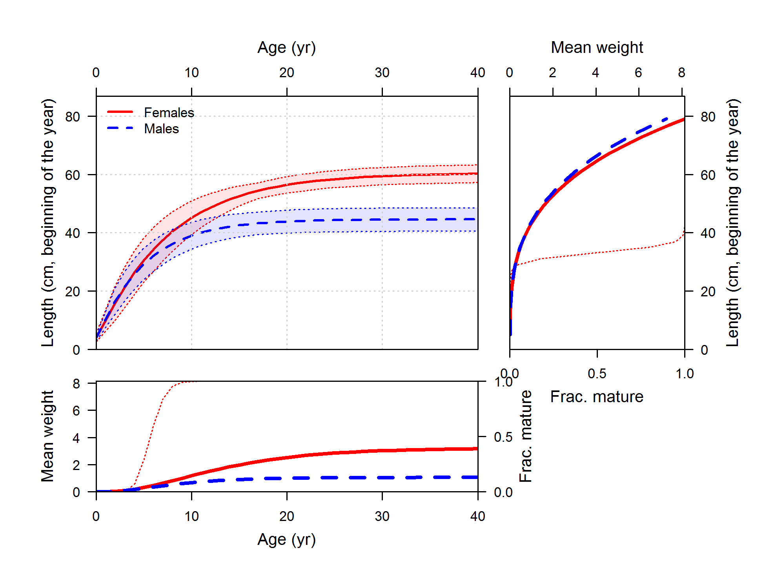

Slide 42
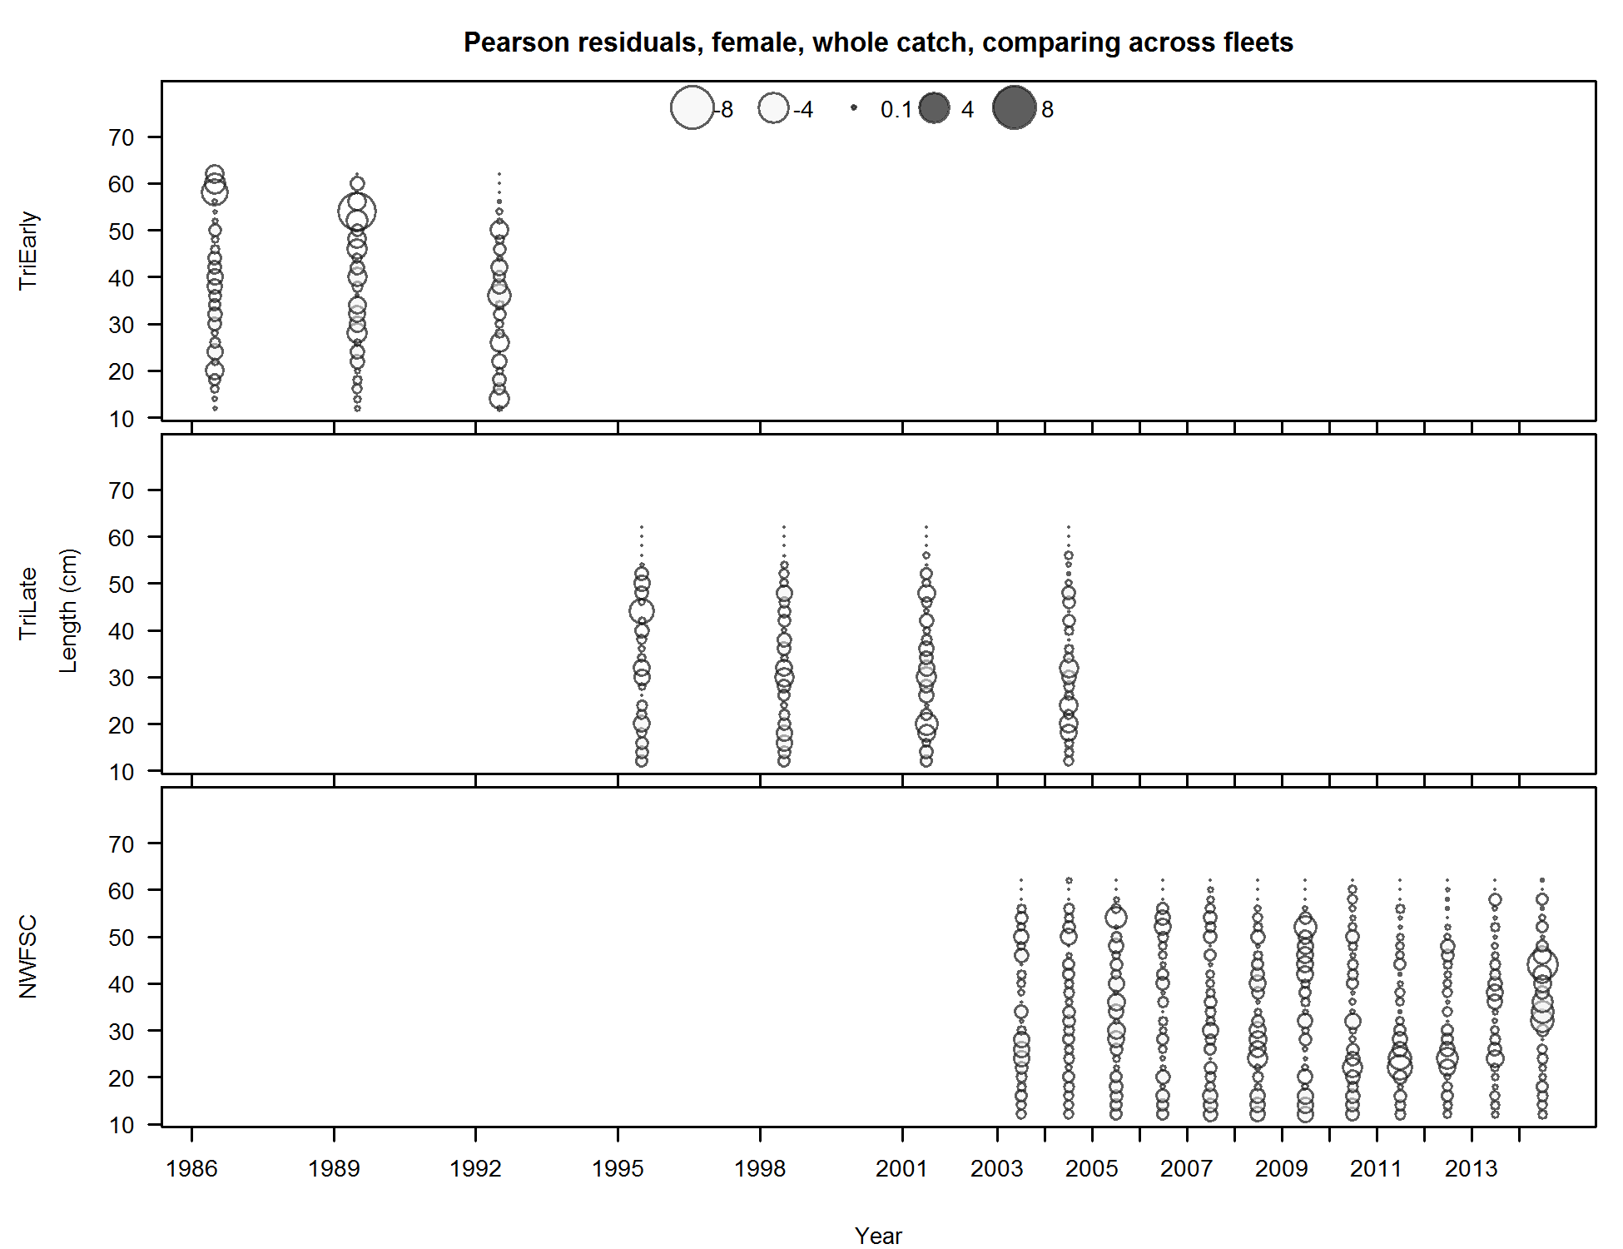

Slide 43
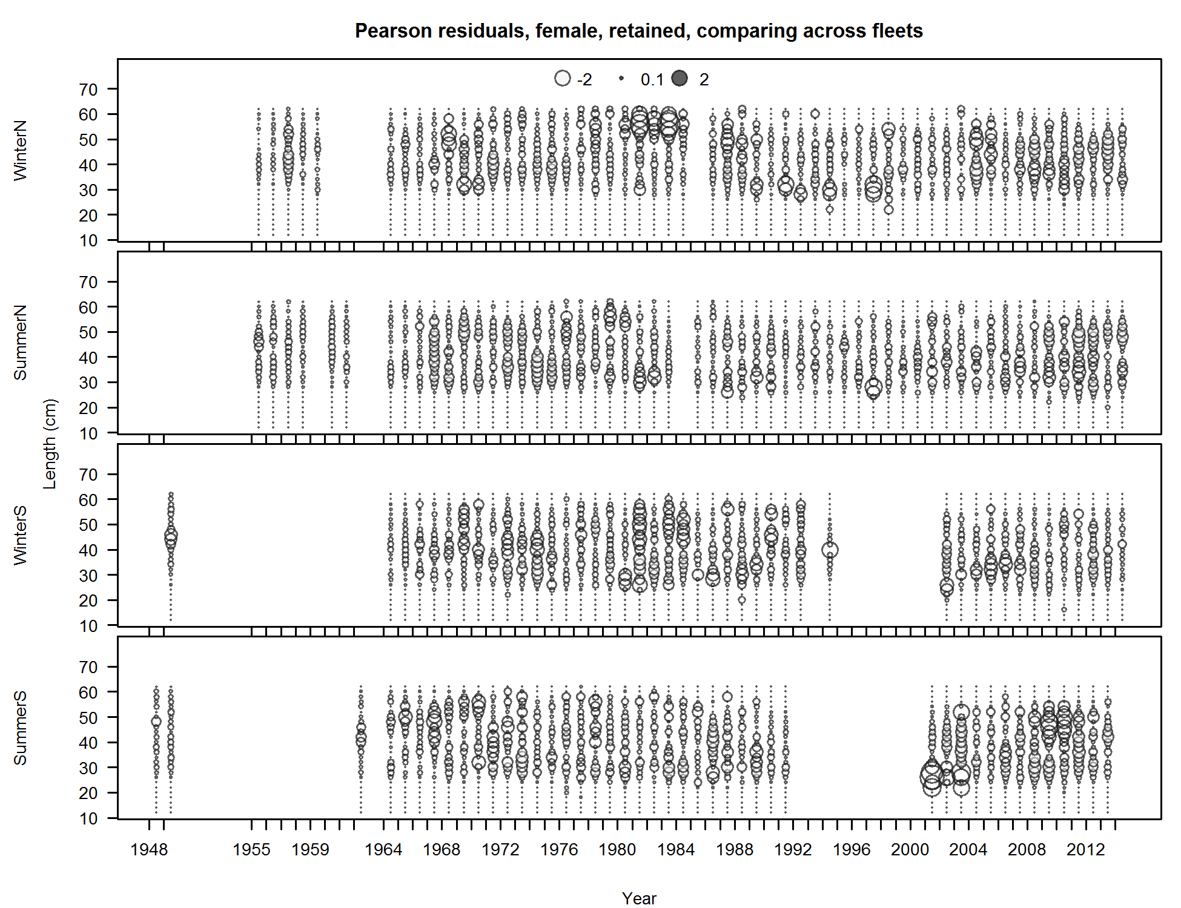

Slide 44
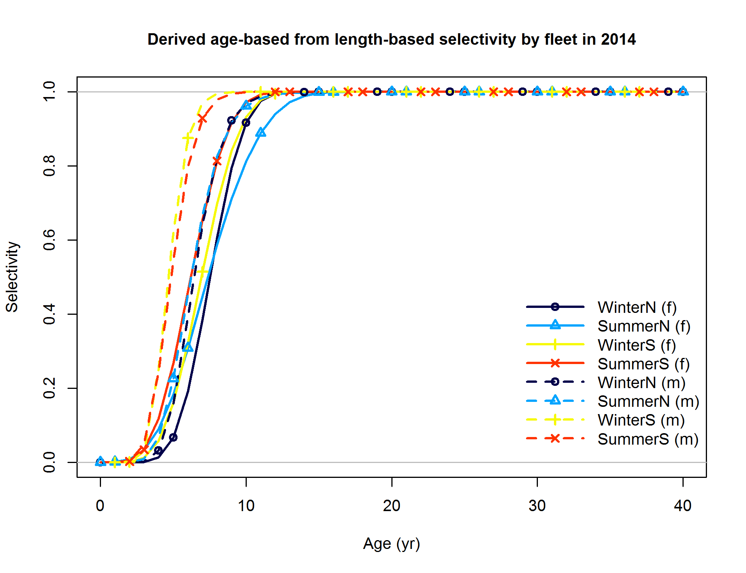

Slide 45
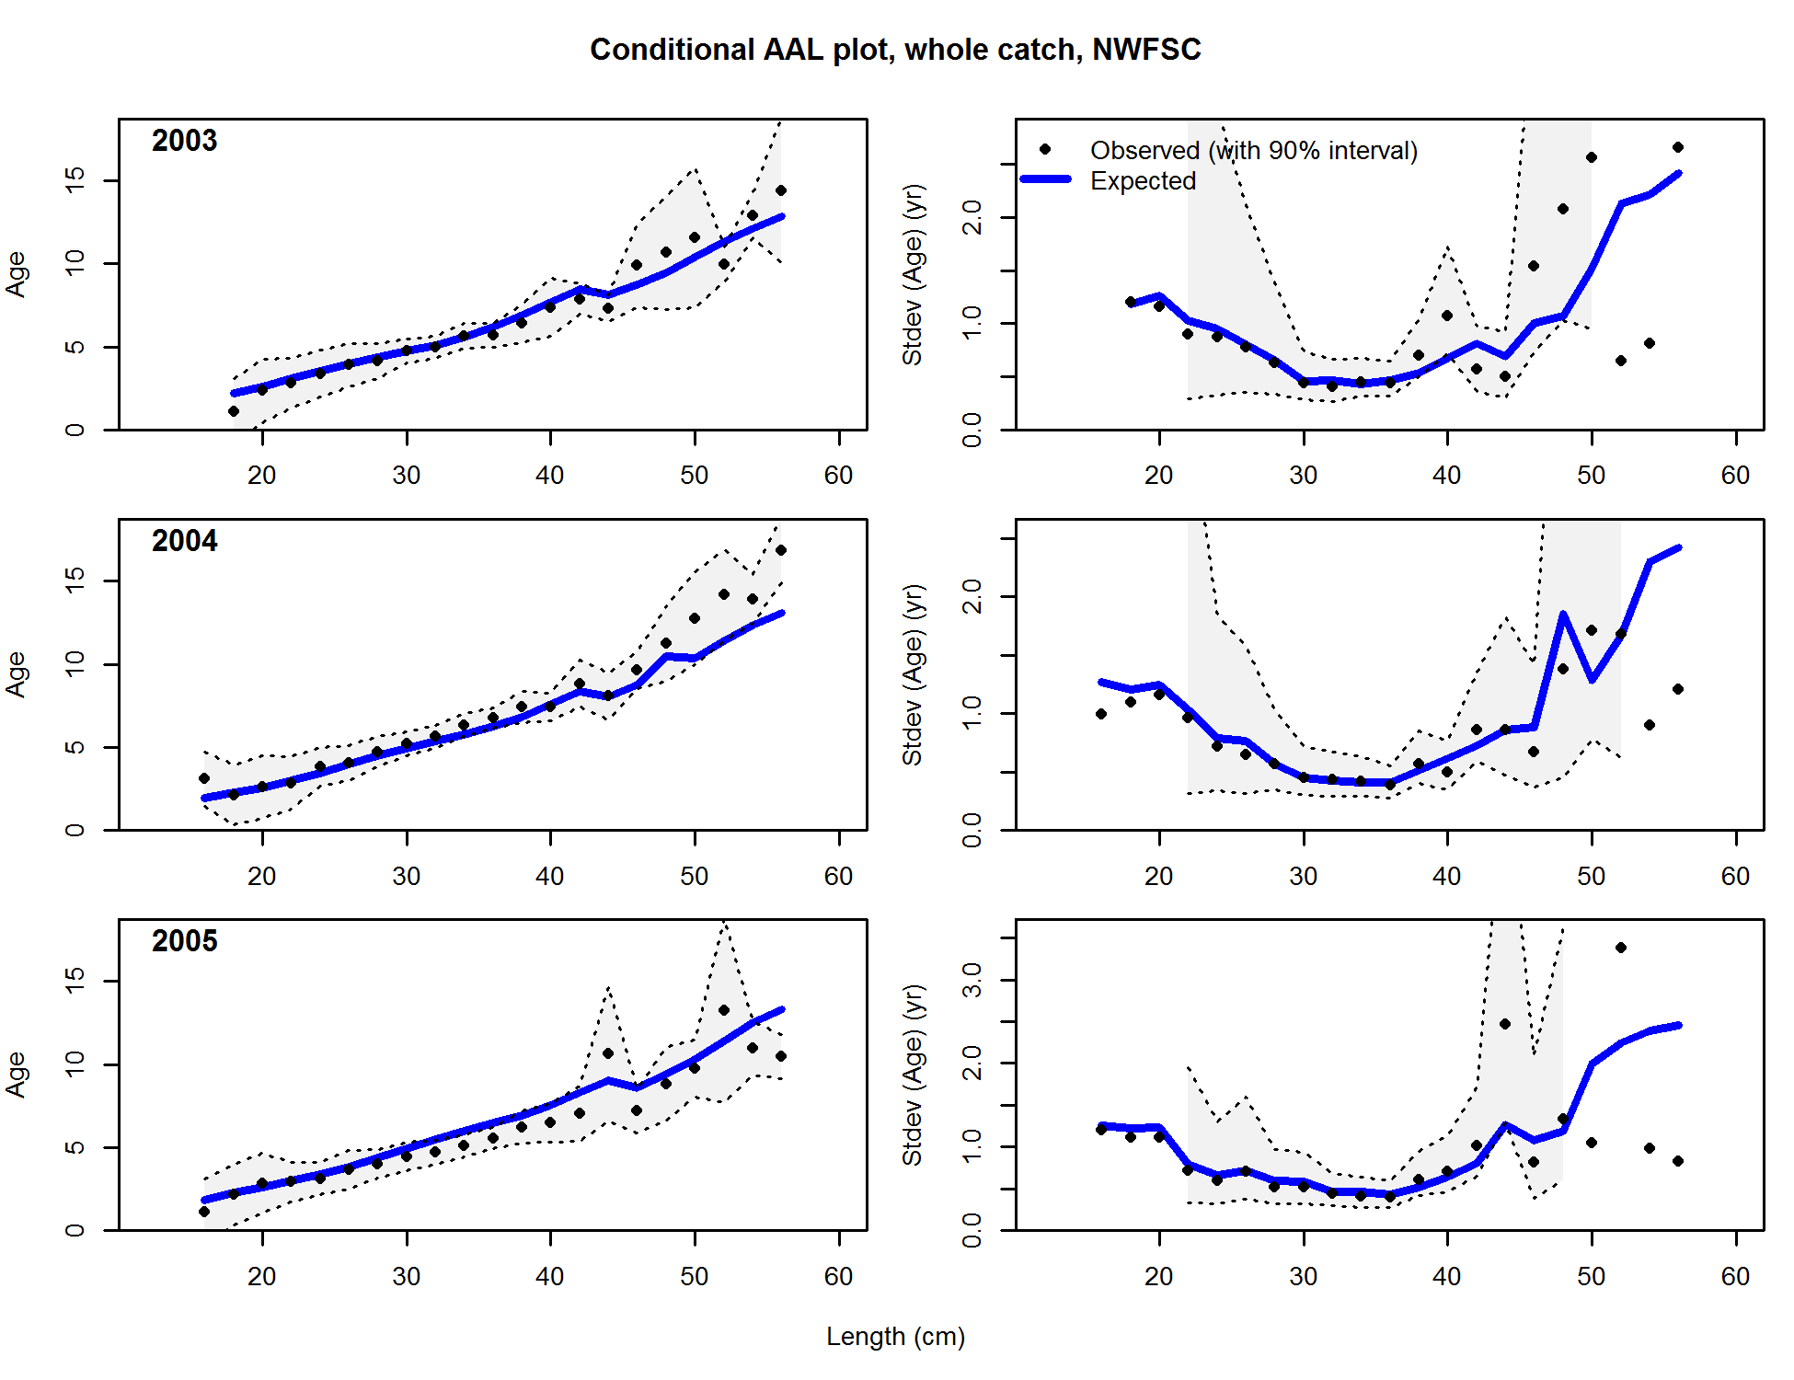

Slide 46
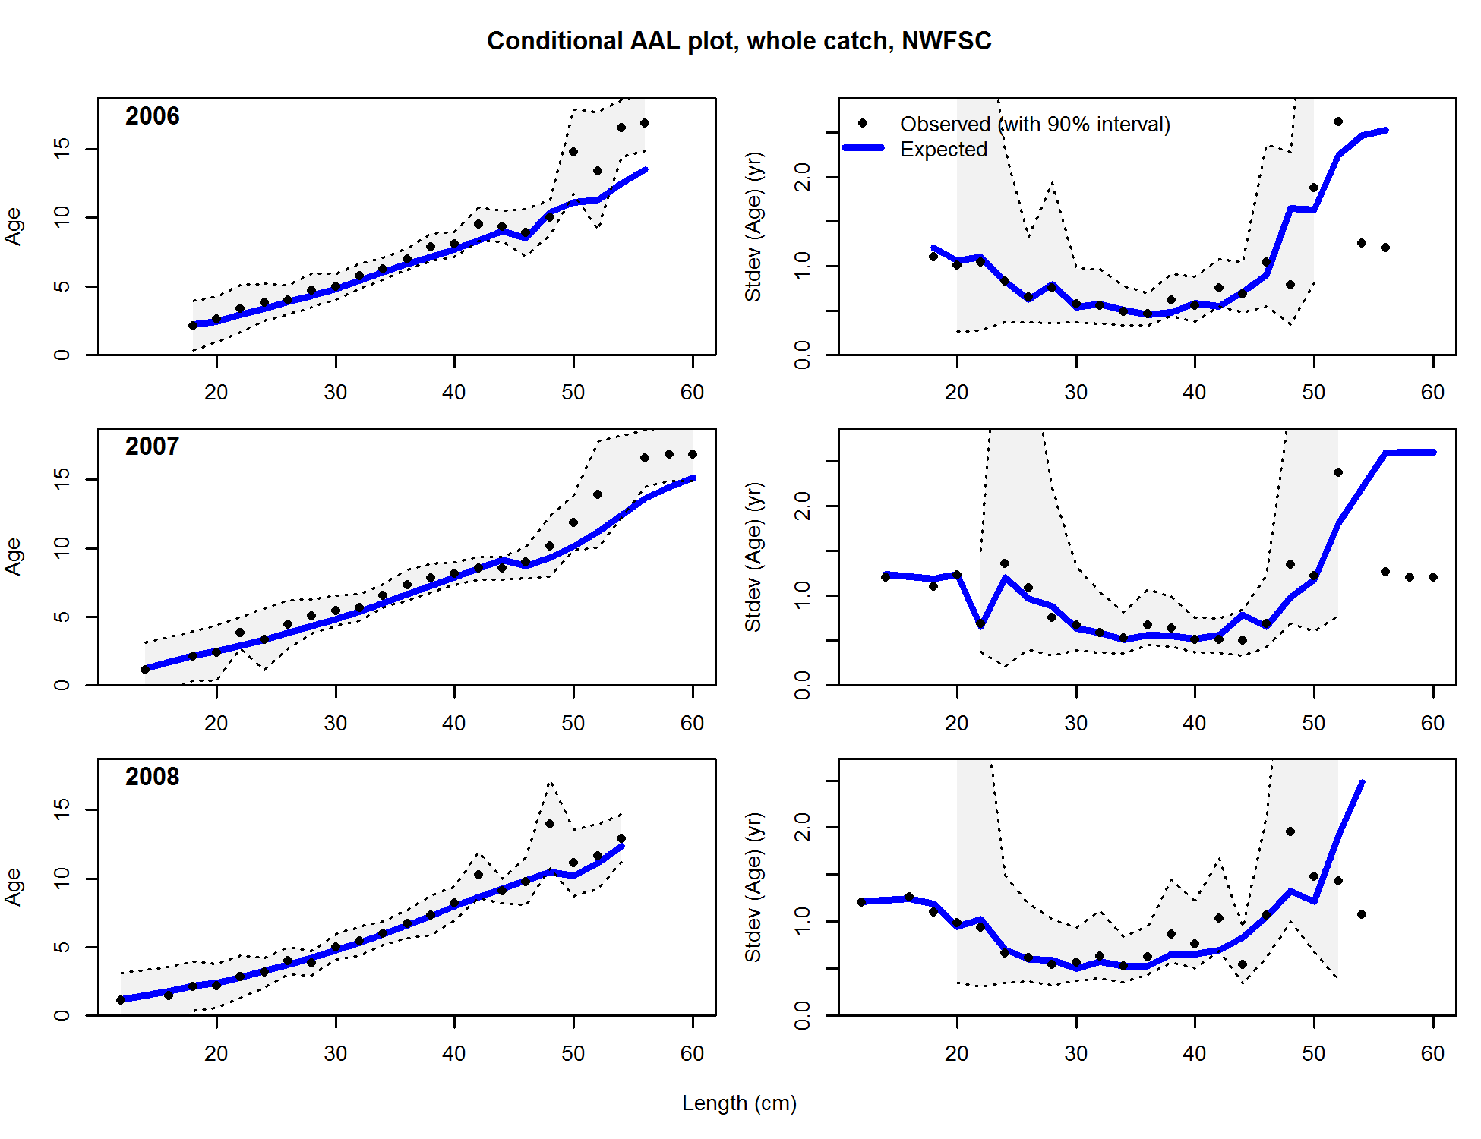

Slide 47
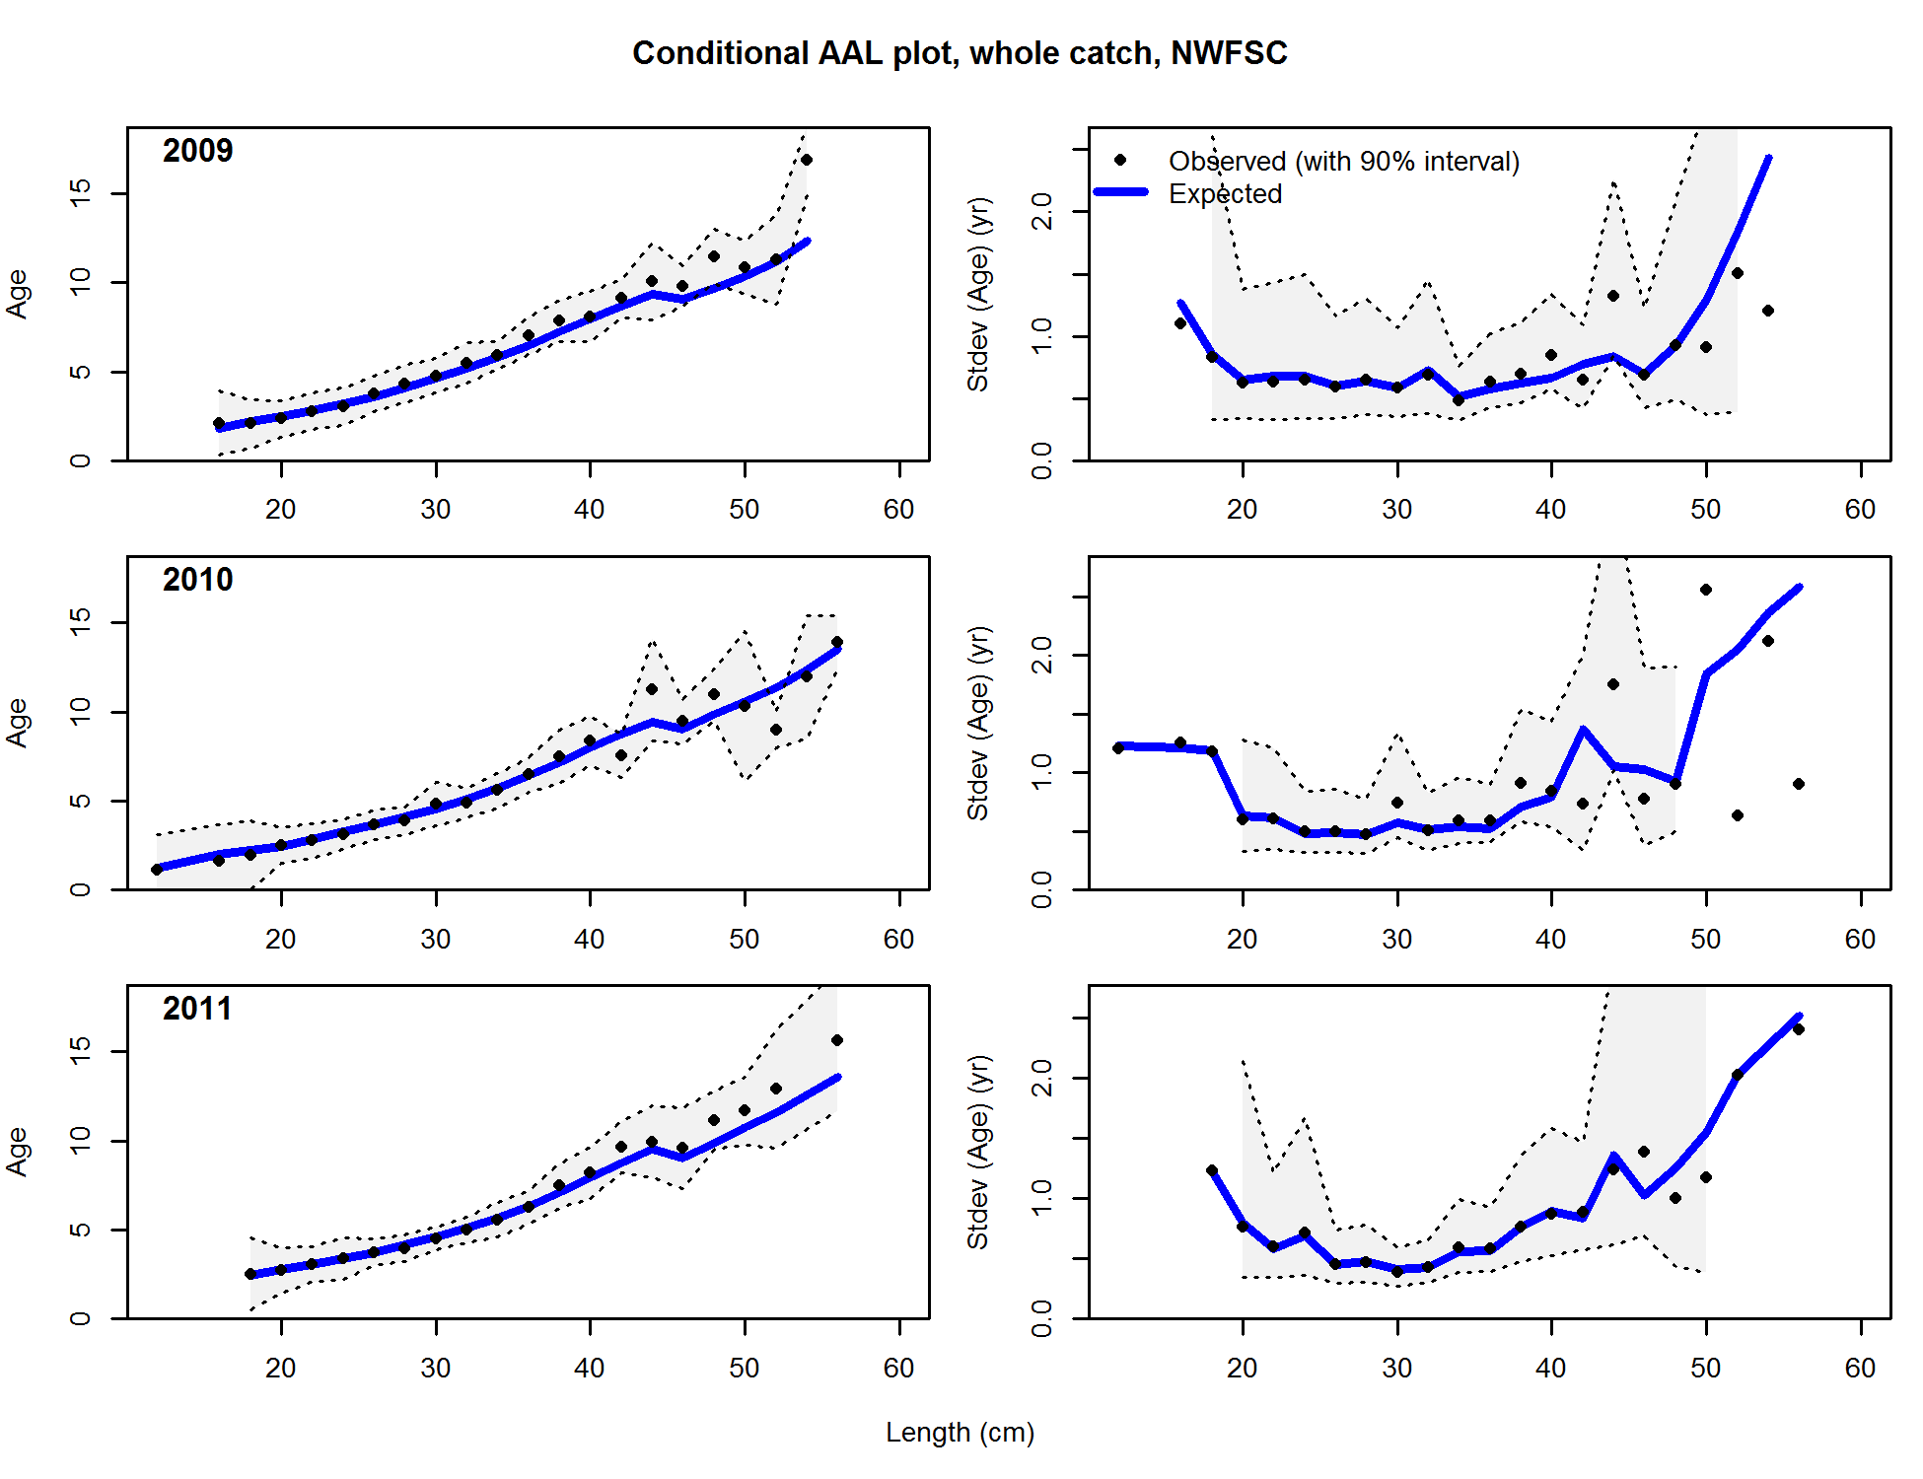

Slide 48
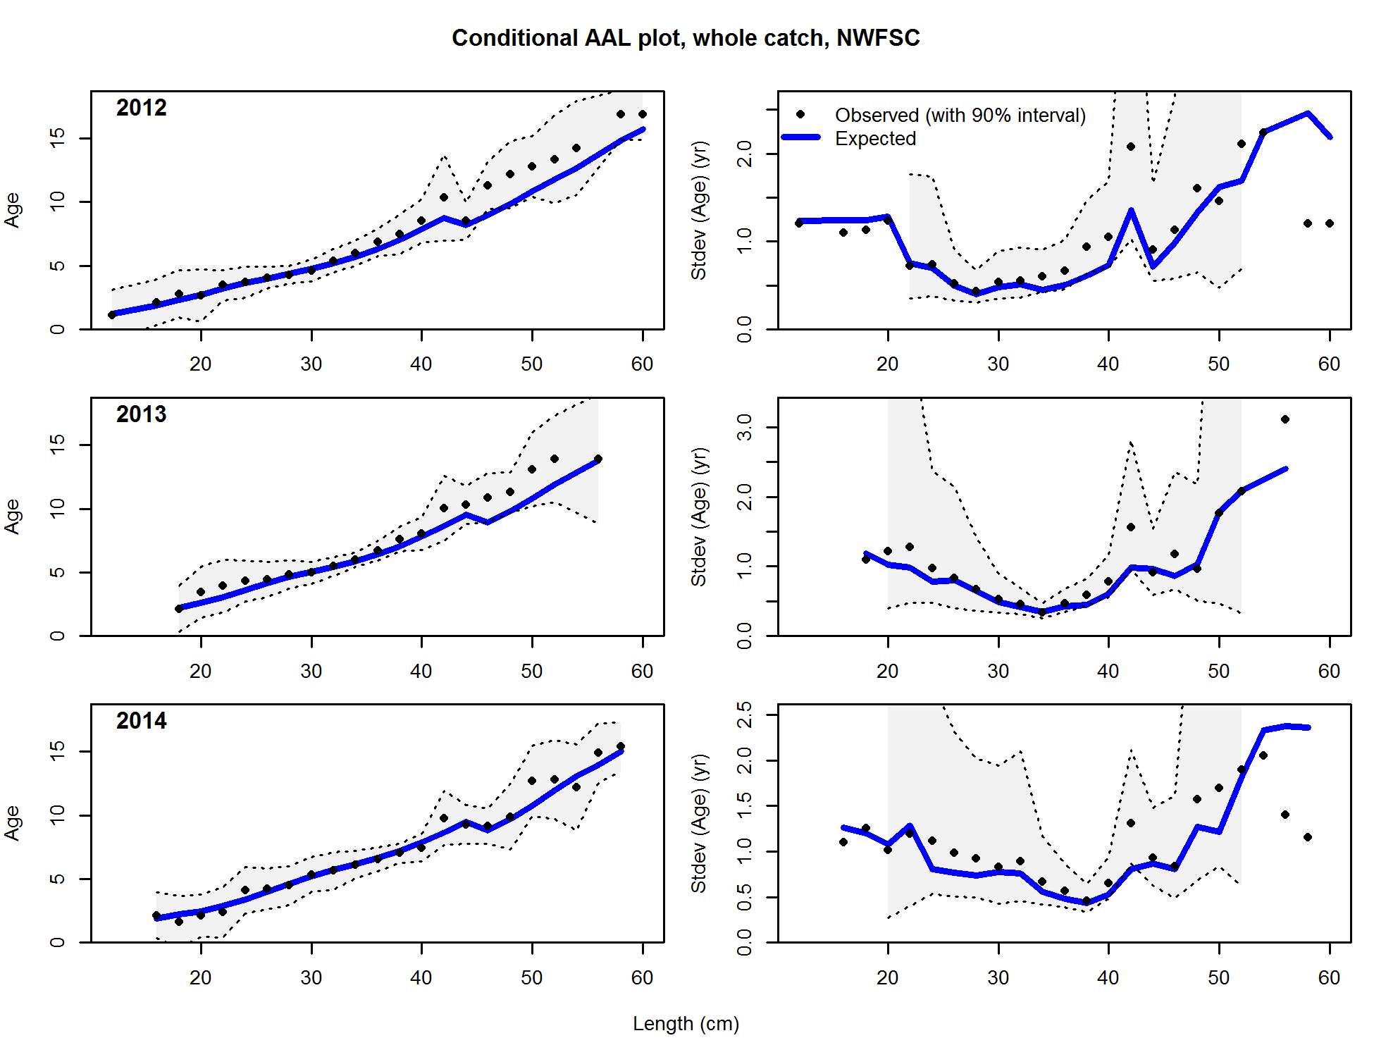

Slide 49
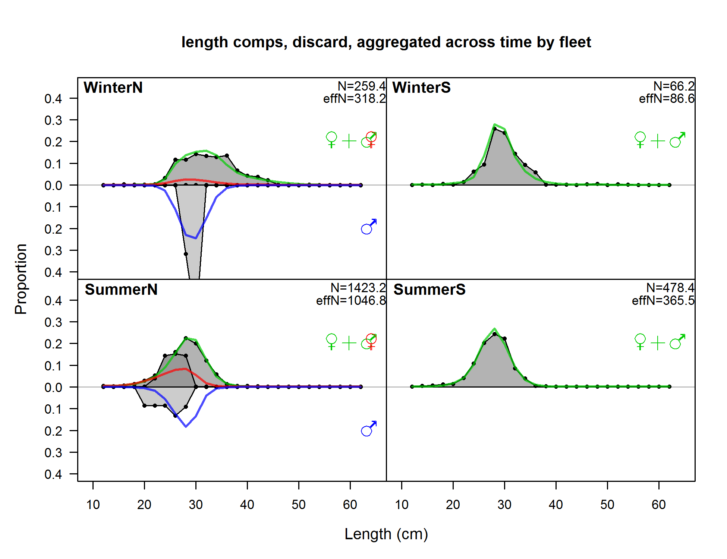

Slide 50
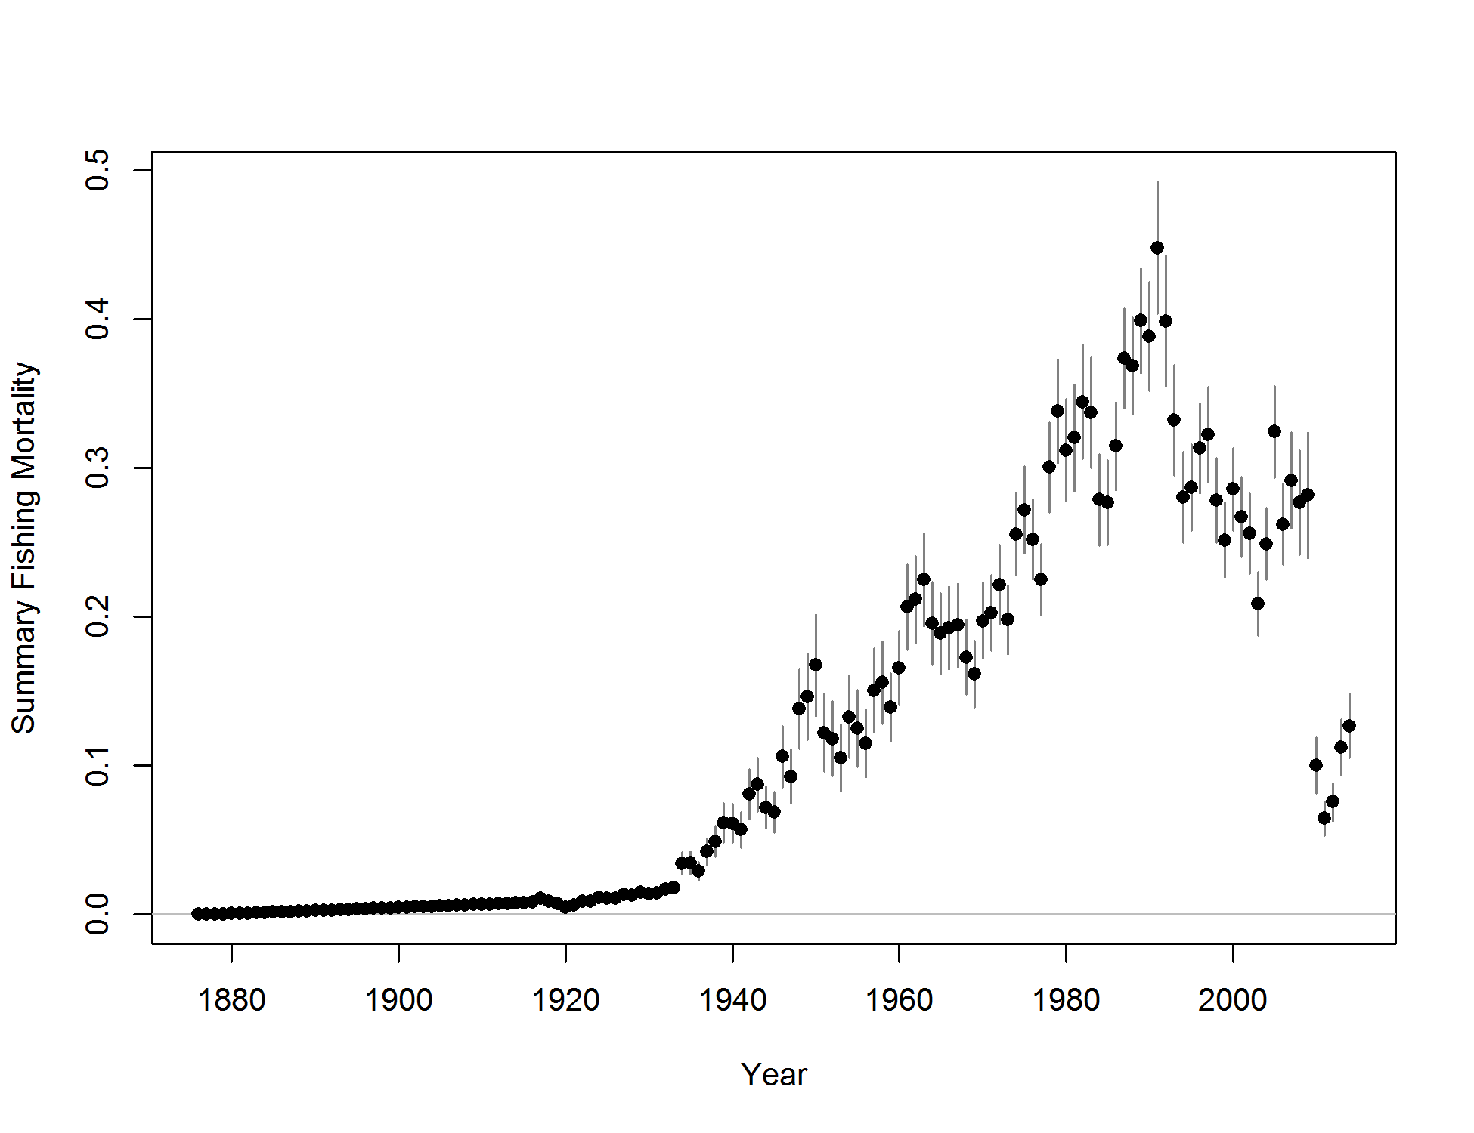

Slide 51
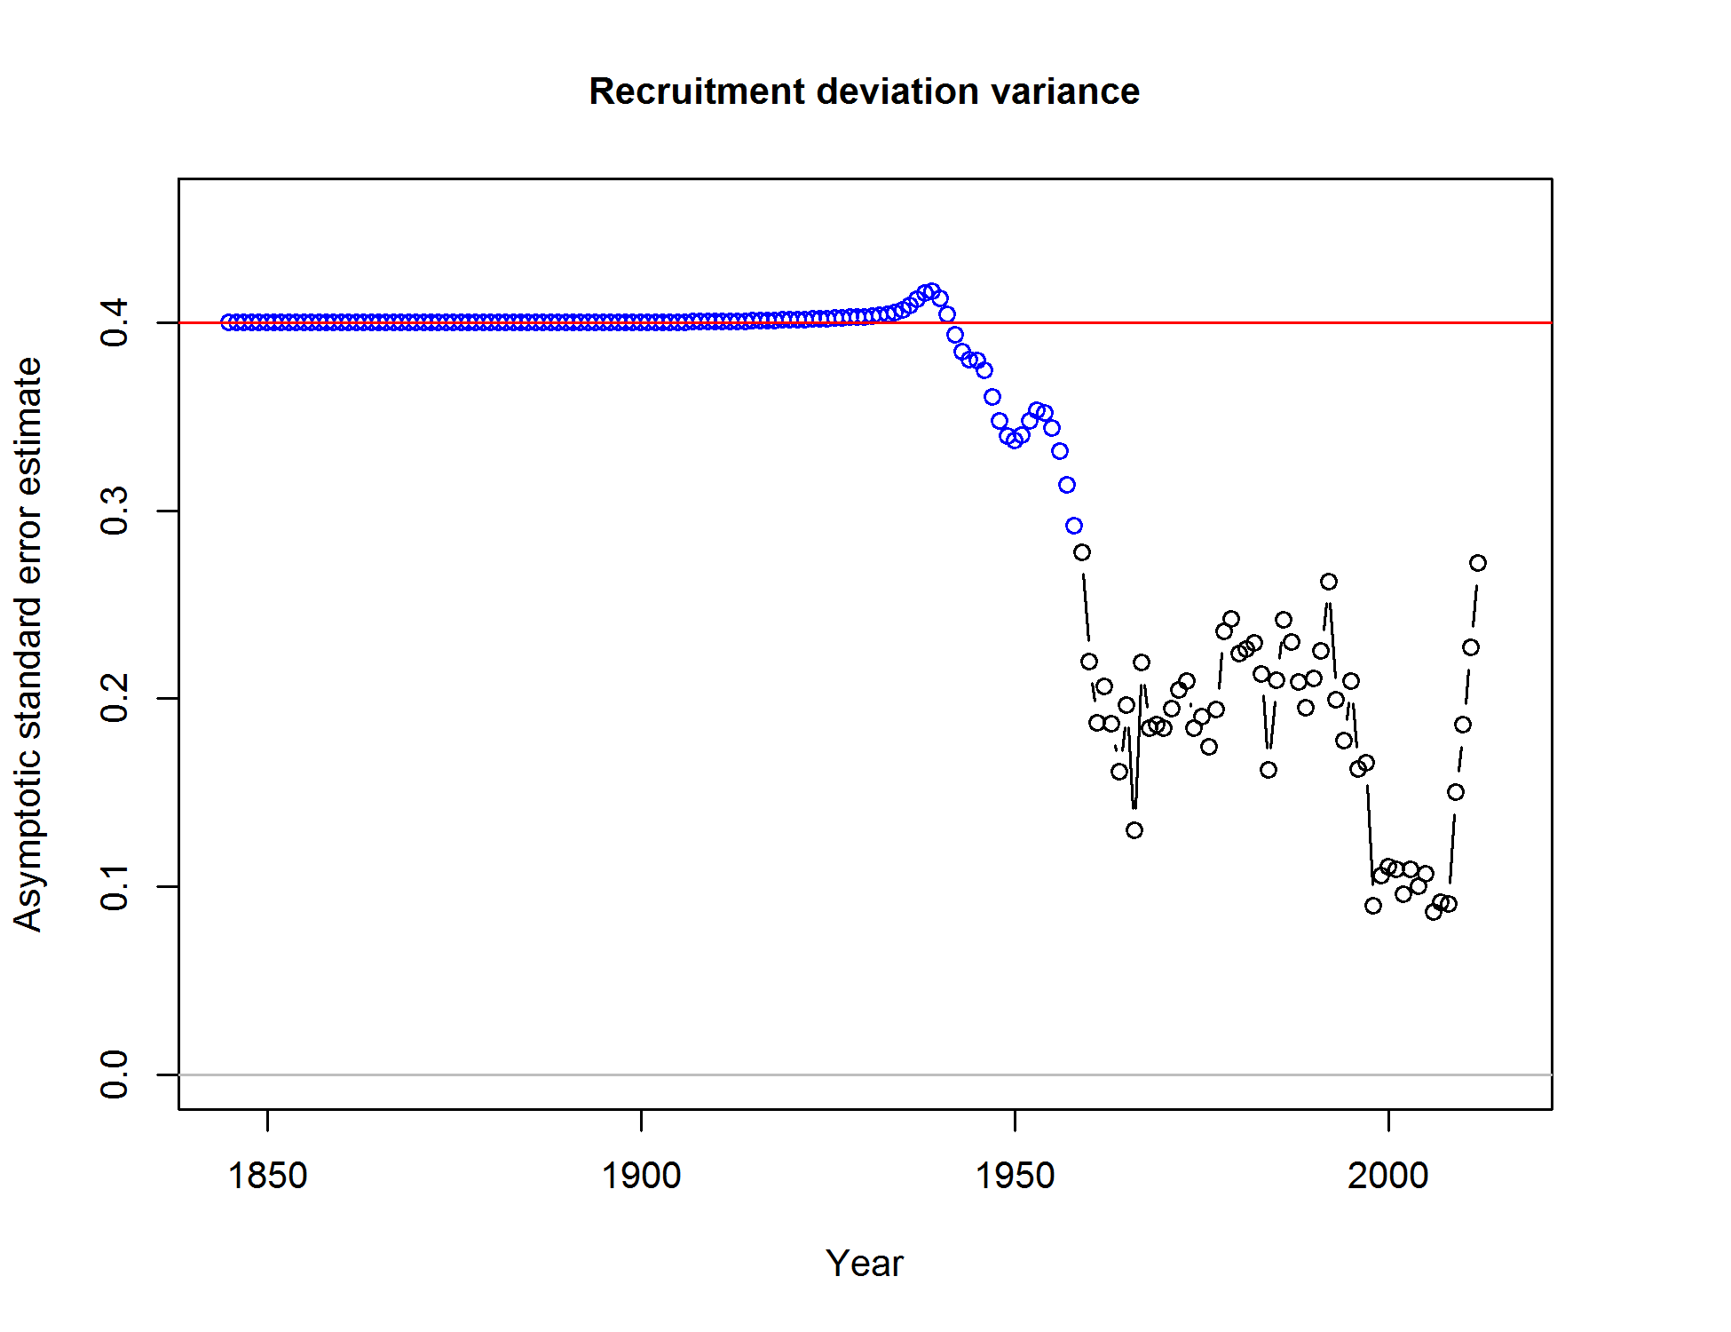

Slide 52
